Slide 1
Autoimmune processes
Jana Švarcová, Tomáš Kučera

Slide 2
Autoimmune (AI) diseases
Autoimmune response involved in their mechanism
  (against one or more autoantigens)
primary pathological process – tissue damage by the immune response
  autoantibodies
  autoreactive cells (mostly CD4 T-cells, also CD8 a B-cells)
  infiltration of affected tissues by immune cells
    example: Hashimoto thyroiditis – antibodies against thyreoglobulin or some other thyroid proteins followed by infiltration by lymphocytes and monocytes
secondary pathological process – malfunction of the damaged tissue
    example: Hashimoto thyroiditis – functions of all thyroid hormone dependent organs are affected (hypothyroidism)

Slide 3
AI diseases caused by antibodies
different Ab classes lead to different damage mechanisms
lysis caused by complement (AI hemolytic anemia – Ab against erythrocytes => attack by complement => lysis => anemia)
opsonization (AI thrombocytopenia – Ab against platelets => opsonization => phagocytosis by phagocytes (liver, spleen) => poor clotting)
receptor function inhibition (myasthenia gravis – Ab against muscle acetylcholine receptors => poor signal transduction in neuromuscular junctions)
receptor function stimulation (Graves-Basedow disease – Ab against thyroid TSH receptor – its binding to the receptor activates it => hyperthyroidism)
block of another biological function (pernicious anemia – Ab against intrinsic factor IF => poor vitamin B12 absorption)
depositions of immunocomplexes (systemic lupus erythematodes – impaired clearing of immunocomplexes from the blood => deposition in capillaries of the kidneys, skin, joints)

Slide 4
AI diseases of unknown cause
the primary step cannot be associated to an antibody
it is not yet appreciated, which of the immune mechanisms is the primary one (or several)
Examples: HT, RA, DM I
  the primary pathol. process consists of an autoimmune damage to the affected tissue (as usually)
  the exact cause (the first step of the primary process) is unknown

Slide 5
Etiology of AI diseases
risk factors
  genetic – predisposition
  external (environmental) – triggering factors
genetic
  given by structural and non-structural gene polymorphism
  different alleles associated to different risk levels of certain AI diseases
  MHC genes (especially MHC II)
    MHC II proteins present antigens to CD4 T-cells
    most AI diseases related to CD4 T-cells
    alleles of MHC genes are a risk factor in about 50 % AI diseases
  other genes
    genes related to sex (most AI diseases more (or much more) frequent in women)
      sex hormones seem to influence immunity
    AIRE gene – transcription factor controlling organ specific protein expression in thymus marrow => influences also clonal deletion of T-cells
    CTLA4 gene – T-cell receptor of inhibitory signals
    genes of insulin (DM I) and thyroglobulin (HT)
    genes related to cytokines and their receptors and to apoptosis
    genes of some autoantigens

Slide 6
Etiology of AI diseases
external factors
  infectious agents (rheumatic fever – Ab against streptococal antigen cross-react with cardiac, joint and kidney components)
  drugs and their metabolites – binding to an autoantigen, which then „look like foreign“
  xenobiotics from the environment – various damages making some tissues accessible for autoantibodies (lung bleeding of smokers – the basal membrane is made accessible)
  some normal food componentsy – not proved yet

Slide 7
Autoimmune diseases
Organ-specific
Diabetes mellitus type 1 – pancreatic islets
Hashimoto thyreoiditis and Graves-Basedow disease - thyroid
Coeliac disease, Crohn disease, ulcerative colitis – digestiv tract
Multiple sclerosis, Guillain-Barré syndrome - CNS
Addison disease – adrenal glands
Primary biliar cirhosis, sclerosing cholangitis, autoimmune hepatitis – liver
Systemic
Rheumatoid arthritis – joints, less often lung or skin
Systemic lupus erythematodes – multiorgan disease, including vitally important organs (kidneys, brain) skin, joints, kidneys, heart, brain, erythrocytes…
Scleroderma – connective tissues (collagenosis); chronic progressive character. First it affects skin and motion apparatus, then internal organs.
Sjögren syndrome – salivary and lacrimatory glands, joints
Goodpasture syndrome – lung and kidneys
Wegener granulomatosis – necrotizing vasculitis – affects respiratory tract, forms granulomas, glomerulonephritis
Polymyalgia rheumatica - inflammatory rheumatic disease, mainly elderly population.
- painful pelvic and shoulder systems, cervical muscles – their strong stiffness

Slide 8
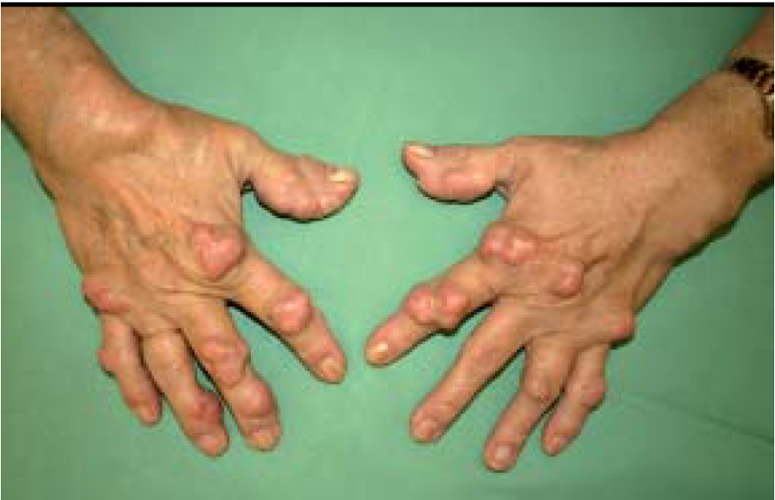
Rheumatoid arthritis
systemic autoimmune disease characterized by inflammatory polyarthritis
(chronic inflammation – synovial hypertrophy with inflammatory cells infiltration, destruction of the articular cartilage and decalcification of the bone
incidence – mainly young people (20-40 years of age) and premenopausal women
prevalence of women (2–3 : 1)
about 1% of the population

Slide 9
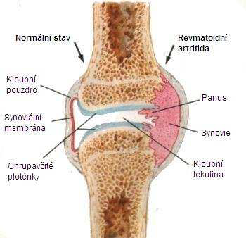
Rheumatoid arthritis
(RA)
Joint
Affected
by RA
Normal Joint
Joints
Capsule
Pannus
Main symptom of RA – symmetrical swelling and pain of many joints; especially small joints of the limbs, accompanied by a morning stiffness lasting more then 1 hour, gradually leading to development of articular destructions and deformities.
Synovium
Synovium
Cartilage
Synovial
fluid
Bone Loss
Bone
etiology – the cause of its development is still unknown. There are more factors (genetic predisposition, viral and bacterial Ag), which activate the immune systems. In 80% patients – rheumatoid factors are present (Ab against Fc fragment of IgG).

Slide 10
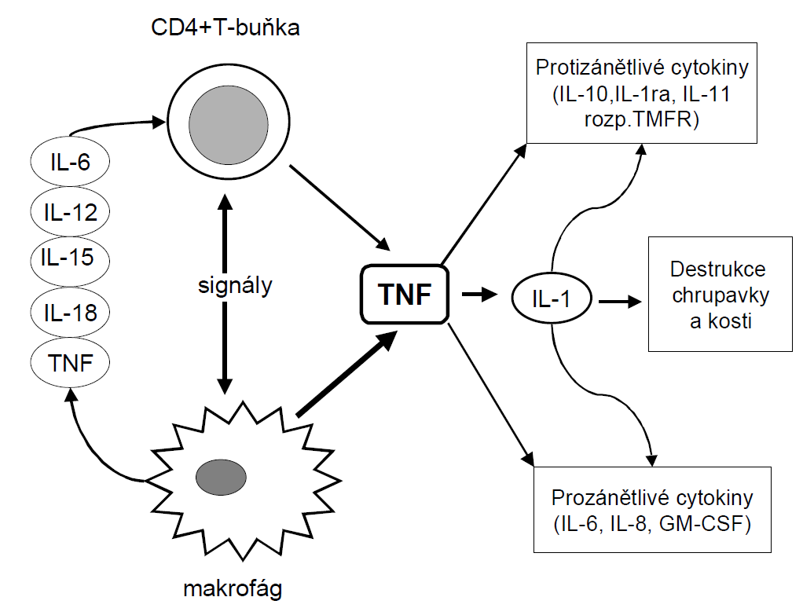
Effect of cytokines on RA pathogenesis
autoantigen – T-cells activation and proliferation → production of pro-inflammatory cytokines → autoimmune reaction
leading to an established local immune reaction in the tissue – lymphocytes, neutrophils, macrophages
key role – T-lymphocytes, which then activate B-cells producing Ab in the affected joint
CD4+ T-cells
anti-inflammatory
Join and Bone loss
signals
pro-inflammatory
macrophages
Inflammatory cells produce reactive oxygen species (originally intended to eliminate Ag) → excess of radicals → destruction of the cartilage (chondrocytes) and bone cells

Slide 11
Diagnostics - laboratory findings
Inflammatory markers – reactants of the inflammation acute phase (CRP), ↑↑ FW
Serum proteins electrophoresis – acute/chronic state (α₂-globulins/ γ-globulins), ↓Alb
autoantibodies:
  rheumatoid factors (RF) – Ab against the Fc part of IgG in 70–80% patients with RA (so called serum positive)
  ∼ 20% patients – test negative (so called serum-negative)
  antinuclear antibodies (ANA) - positive 33–52% cases
  Antibodies against citrullinated cyclic peptide (ACPA) – high specificity ∼ 80% patients (∼ 1% population)
  antiperinuclear factors (APF)
Synovial fluid – yellow, turbid, with low viscosity

Slide 12
RA diagnostics II.
anamnesis focused to rheumatological symptomatology
arthrosonography (early stages of RA)
X-ray examination of the joints
MR

Slide 13
RA therapy
Pharmacotherapy of RA – 3 categories of drugs:
  Non-steroid antirheumatics – anti-inflammatory effect (suppress cyclooxygenase synthesis – one of the key enzymes in local inflammation mediators formation) + analgesic effect
  Disease modifying drugs (DMARDs = disease modifying antirheumatic drugs) – chemically and pharmacodynamically heterogeneous group of compounds (beneficially modify the disease symptoms and course by an as yet unclear mechanism)
  - drug effect is onset with a delay (weeks, months), after dropping it can persist
  - undesirable effects – esp. hepatotoxic, hematotoxic and immunosupressive
  Examples: antimalacs (Plaquenil, Delagil), gold salts (Tauredon), sulphasalazine (Sulfasalazin, Salazopyrin), methotrexate, penicillamine (Metalcaptase), azathioprine (Azamun, Imuran), cyclophosphamide (Cyclophosphamid
  corticoids – anti-inflammatory and immunosuppressive effects
  - onset – usually rapid and strong (only temporary effect on the disease symptoms)
  Recently new type of therapy develops - so called biological therapy
  compounds affecting key steps of immune reactions (e.g. the most important cytokines)
  - the principle – monoclonal Ab or receptor antagonists of those cytokines

Slide 14
Multiple sclerosis (MS)
Chronic inflammatory disease in which the insulating covers of nerve cells in the brain and spinal cord are damaged
The attack of myelin starts inflammatory processes
Myelin, the target antigen of the autoimmune attack → enhance the loss of myelin, or they may cause the axon to break down completely

Slide 15
Epidemiology MS
The prevalence of MS patients – is highly variable among different regions = influence of latitude
  the incidence of the disease increases with distance from the equator, the most abundant in the temperate zone of the northern hemisphere
MS usually appears in adults in 20-40 years of age
Similar to many autoimmune disorders, the disease is more common in women (2:1)
The number of people with MS is approximately 100 per 100,000)
however, a number of genetic variations have been shown to increase the risk

Slide 16
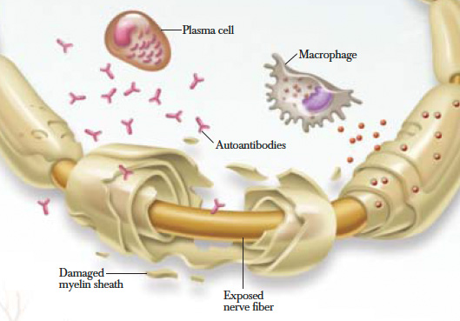
Pathophysiology MS
the inflammatory process is caused by T cells that plays an important role in the development of the lesion
The T cells recognize myelin as foreign and attack it = „autoreactive lymphocytes“
T cells gain entry into the brain via disruptions in the blood–brain barrier

Slide 17
MS signs
∼ 80-85 % patients - a clinically isolated syndrome (CIS) - an individual's first neurological episode, caused by inflammation or demyelination of nerve tissue
relapsing-remitting (RR) MS – initially phase MS; unpredictable relapses followed by periods of months to years of relative quiet (remission) with no new signs of disease activity
however after 10 – 15 years about 60% of these patients show a transition into a secondary progressive disease course (SP) MS that is characterized by a gradual decline of neurological function
The primary progressive subtype (PP) – occurs in approximately 10–15% of individuals, with no remission after the initial symptoms. It is characterized by progression of disability from onset, with no, or only occasional and minor, remissions and improvements. (10-15% patients; men + around 40 years old)
Malignant - Progressive relapsing MS - individuals from onset, have a steady neurologic decline but also attacks

Slide 18
MS symptoms
The specific symptoms are determined by the locations of the lesions within the nervous system
  may include loss of sensitivity or changes in sensation, visual problems (optic neuritis), feeling tired, acute or chronic pain, difficulties with coordination and balance and others.
  ∼ 30% individuals - Difficulties thinking, …
  General symptoms – 55% patients - emotional problems such as depression or unstable mood

Slide 19
Diagnostics MS
typically dg - based on the presenting signs and symptoms, in combination with supporting medical imaging and laboratory testing
Dg – abnormal results:
  neuroimaging, analysis of cerebrospinal fluid (CSF) and evoked potentials (EP)
evidence of lesions at different times and in different areas – dg MS - McDonald criteria (focus on clinical, laboratory, and radiologic evidence)

Slide 20
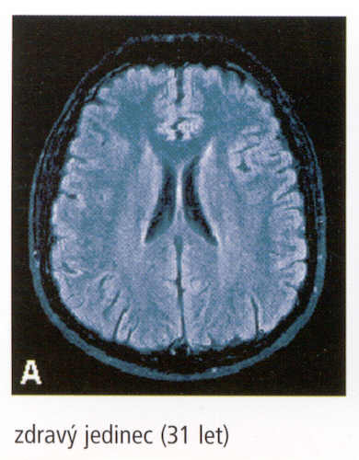
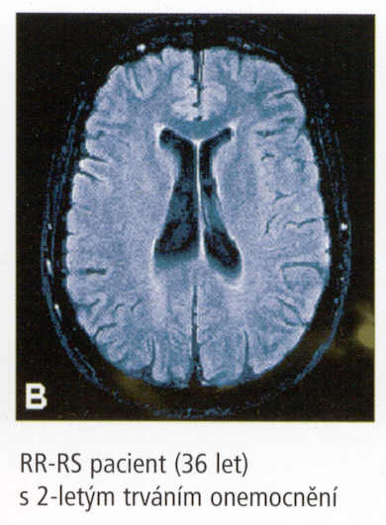
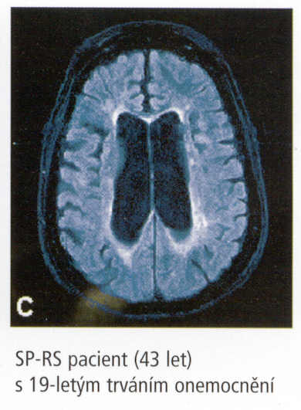
MRI – dissemination of brain lesions in time and space
Healthy (31 year old)
RR-MS, 2 years duration (36 year old)
SP-MS, 19 years duration (43 year old)

Slide 21
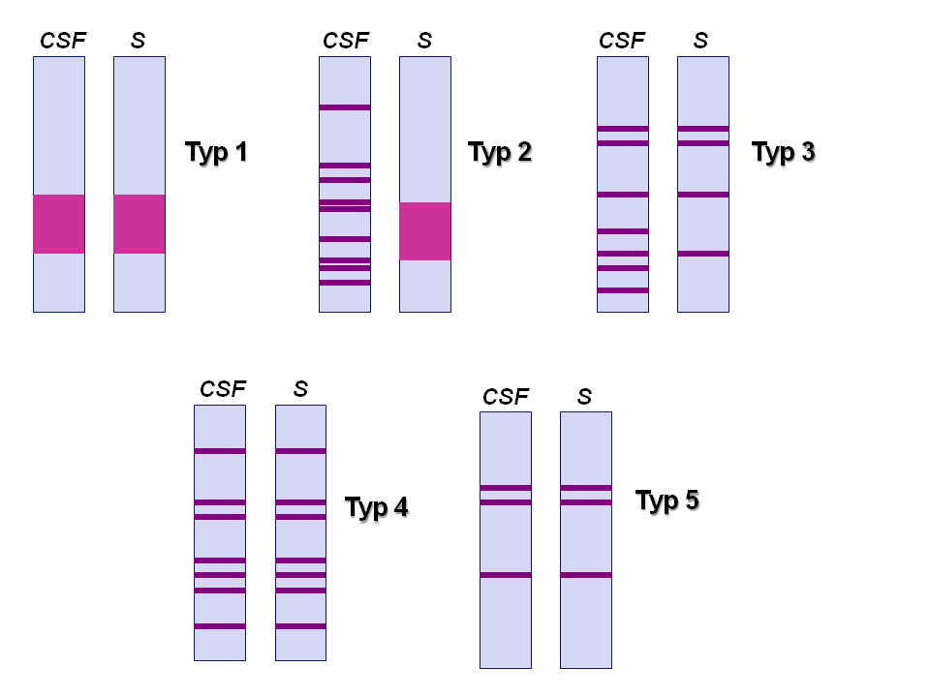
Diagnosis – Laboratory results
CSF analysis – intrathecal synthesis IgG
  qualitative – Oligoclonal bands IgG
  quantitative – increased CSF levels IgG in CNS
Type 1 – healthy
individuals
Type 2 – oligoclonal bands are present only in CSF – local production IgG (MS)
Typ 3 – oligoclonal bands are present not only in CSF; the others in serum – local IgG production in organism (chronic infection CNS, MS)

Slide 22
Therapy
The primary aims of therapy - returning function after an attack, preventing new attacks, and preventing disability
Acute attacks – corticosteroids
Long-therm therapy – preventing new attacks and preventing disability (interferon beta-1a, interferon beta-1b, glatiramer acetate)
Associated symptoms – (pain, spasm, tiredness, depression)

Slide 23
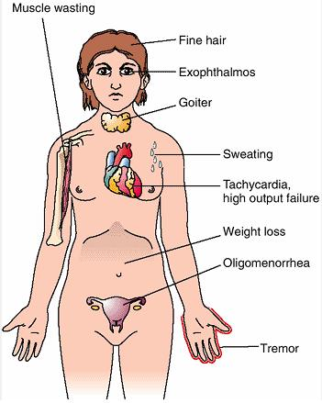
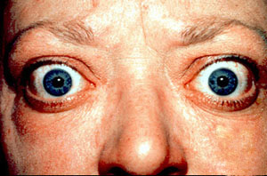
Graves-Basedow disease
Thyroid hyperfunction (thyreotoxicosis)
symproms
  hyperthyroidism
  thyreotoxicosis
  often exophthalmos

Slide 24
Graves-Basedow disease
imunogenetics
  women/men 7/1
  Associations with
    HLA-A1 B8 DR3 (not very strong)
    HLA-Bw35 a Bw46 Asiats
    HLA-DR3 (strong association of the exophthalmos)
immunopathology
  Infiltration by CD4⁺ T-cells
  exophthalmos – antibodies against an unknown Ag (common to thyroid?) in the retroorbital fibrous tissue
autoantibodies against
  MHC
  TPO (thyroid peroxidase) – 50–80%
  thyreoglobulin – 20–40%
  TGSI (autoantibodies stimulating (growth of) thyroid; against IGF1-R – „insulin-like growth factor 1 receptor“) – 20–50%
  TSI (autoantibodies stimulating thyroid) – bond to the TSH receptor and its activation – 50–90%
  TBII (TSH-binding inhibitor immunoglobulin) – 50–80% (prevent TSH binding to the receptor)
  Presence of TSI a TBII – probable relapse or (if in pregnant woman) affected newborn
therapy
  ocular symptoms
    steroids, cyclosporine, irradiation (limitation of the inflammatory process)
    Rituximab – monoclonal antibody against CD20 (antigen of B-lymphocytes - to limit their activity)
    surgical intervention
  Ablation of thyroid with ¹²⁵I isotope

