Slide 1
Biochemical bases of neuropsychiatric and neurodegenerative disorders
Jan ILLNER
Jana Švarcová

Slide 2
Myasthenia gravis

Slide 3
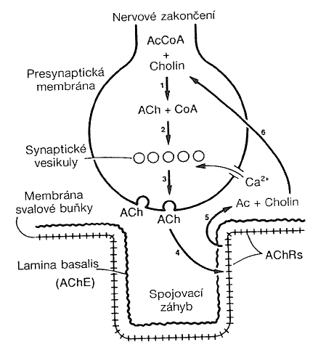
Characterization: repetitive episodes of muscular weekness that is
accented after physical load, ptosis, diplopia, troubles with speech
Therapy: drugs that inhibit AChE
Ab against AChRs of neuromuscular linking are generated from unknown reasons
Destruction of AChRs follows with decreasing of their levels (immunopathogenes)
Scheme of neuromuscular transport:
1. ACh synthesis (ACh-transferase)
2. Incorporation and storage of ACh
3. ACh is released into synaptic cleft by
exocytosis, depolarization of nerve synapse, Ca²⁺ channels are opened, Ca²⁺ is necessary for exocytosis
4. ACh diffuses to receptors (*), transmembrane channel is opened, ions can flow across membrane
5. Channel is closed, ACh is released and hydrolysed by enzyme AChE
6. Recycling of ACh by active transport mechanism
Presynaptic membrane
Choline
Synaptic vesicles
Muscular ´s cell membrane
Choline
Linking meander

Slide 4
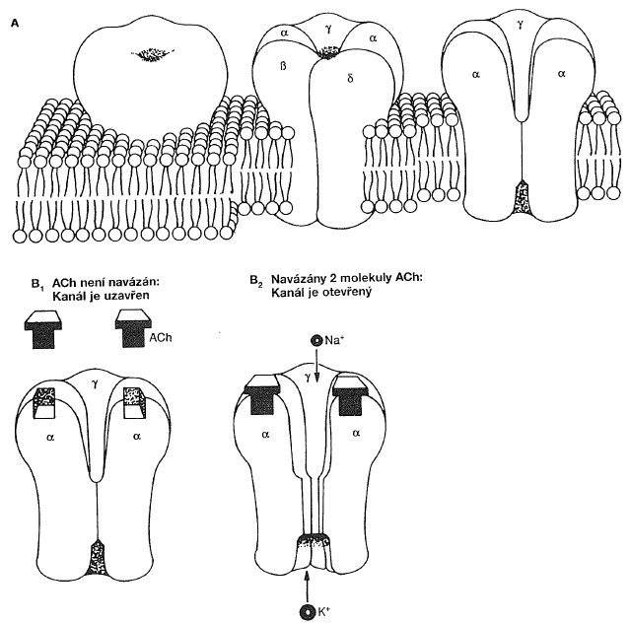
(*) Structure of ACh receptor of neuromuscular linking
Ach is not bounded:
Channel is closed
2 molecules of Ach are bounded:
Channel is opened
2 molecules of ACh are bonded
entrance of Na⁺ cause depolarisation of muscular membrane
action potential is produced and transported
contraction is caused
ion channel is regulated by transmitter

Slide 5
Autoantibodies: present in 80-90 % cases (Ab against AChRs)
production is dependent on T-cells: reactions of T-cell´s receptors of autoreactive lymphocytes
60 % of patients: thymom (benign disorder of thymus)
7 % of patients: serumnegative (AChR-Ab), antibodies against muscular specific tyrosine kinase (Ab anti-MuSK)
MuSK: receptor´s protein on surface

Slide 6
Huntington´s disease (Huntington's chorea)

Slide 7
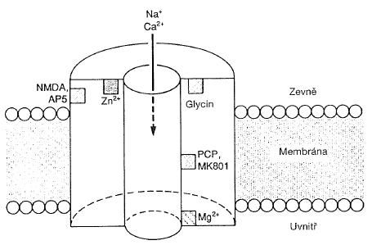
Characterization: short unconscious movements, faster deterioration of neural functions
autosomaly dominantly inherited disorder (50 % of children from impaired parents are affected too)
neurons in corpus striatum are affected the most, neurons die and can be replaced by glial cells (gliosis)
decreasing of: neurotransmitters: GABA, ACh
enzymes associated with synthesis (Glu-decarboxylase, ACh-transferase)
neuropeptides (cholecystokinin), receptors (for ACh, dopamine, serotonin)
gene for HD has not been identified yet
Hypothesis: realising of excitotoxins (exogenous or endogenous)
Glu, Ca²⁺
Structure of Glu receptor
stimulation of NMDA receptor (Glu)
accumulation of Ca²⁺
neurons necrosis in striatum
NMDA (N-methyl-D-aspartic acid)
outside
membrane
inside

Slide 8
Stroke

Slide 9
Characterization: brain tissue damage because of blood flow into the brain is
decreased
Consequences: loss of consciousness, paralysis, blindness, loss of speech ability
Causation: brain arteries thrombosis, brain substrates O₂ and Glc are limited,
substrates shortage = cells damage
Glutamate cascade:
Induction: depolarization of neuronal membrane, Glu is released, excitation of NMDA receptors, entrance of Ca²⁺, Na⁺, neurones damage or death, Glu stimulates AMPA/cainate receptors too (another Na⁺ come into the cells)
Amplification: level of intracellular Ca²⁺ is increased, other Glu is released, other neurons are damaged
Expression: activation of nucleases, proteinases, phospholipases by higher Ca²⁺ levels, by phospholipids degradation arachidonic acid is released, eicosanoids are produced, vasoconstriction, oxygen radicals are generated
Therapy: restrict damages caused by thrombosis
minimalizme biochemical effects of Glu cascade
low amount of acetylsalicylic acid

Slide 10
Parkinson´s disease

Slide 11
Characterization: tremor, bradykinesis, hypokinesis (slow movements), rigidity,
postural instability parkinsonism
Causation: degeneration of pigment cells in substantia nigra
Production and using of dopamine as neurotransmitter (dopaminergous)
Degeneration causes decreased dopamine synthesis and then levels of dopamine in substantia nigra and corpus striatum is decreased too
Decreasing of dopamine levels in cells of nigrostriatum system increase ratio ACh/dopamine (amounts of ACh are not so affectived)
Imbalance in this ratio is associated with generation of movement troubles in Parkinson´s patients
Therapy: anticholinergous therapy
dopamine precursors (L-DOPA)
dopamine receptors agonists (similar effect)
deprenyl (inhibits MAO-B, decreases dopamine degradation)
amantadin (helps with releasing of dopamine from presynaptic terminus)
vs. reserpin, dopamine receptors antagonists – cause parkinsonism

Slide 12
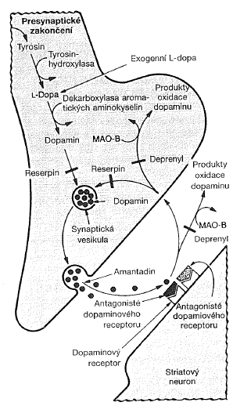
Dopamine releasing by neuron
in substantia nigra
Process of dopamine action :
1. Synthesis from Tyr, tyrosine hydroxylase
2. Storage in synaptic vesicles
3. Releasing by exocytosis
4. Bond to receptor
5. Reverse absorption
6. Degradation, MAO-B
Dopamine
MAO (monoaminooxidase)
DOPAC (3,4-dihydroxyphenylacetic acid)
COMT (catechol-O-methyltransferase)
HVA (homovanilic acid)
1
6
2
6
5
4
3

Slide 13
Schizophrenia

Slide 14
Characterization: mental disease, psychical functions are disordered
(thinking, perception, will, mood, attention, behaviour)
impaired communication among different brain parts
imbalance in chemical substance in different brain parts
patients can not distinguish reality from their own illusions and fantasy
Causation: unknown, starter can be drugs
Dopamine hypothesis (hyperdopaminergy) X hypodopaminergy (PD)
Biochemical measurements:
1. Dopamine levels in brain, large variability
2. Dopamine metabolites in brain and body fluids (homovanilic acid),
great heterogeneity
3. Dopamine receptors (D2), good concordance, neuroleptics compete with
dopamine about D2 receptors

Slide 15
Case report

Slide 16
25 years old woman
About 3 months ago – she complains of increasing muscle fatigue in her lower extremities upon walking. If she rests for 5 to 10 minutes, her leg strength returns to normal. She also notes that if she talks on the phone, her ability to form words gradually decreases. By evening, her upper eyelids droop to the point that she has to pull her upper lids back to see normally.
Physical examination: inability to do specific repetitive muscular activity over time – e. g. talks, ability to form words gradually decreases, squat - repeated squats with difficulty. Head – without headache. Light ptosis of right bulb, diplopia (all direction).
These symptoms are becoming increasingly severe. When Mya is asked to sustain an upward gaze, her upper eyelids eventually drift downward involuntarily. When she is asked to hold both arms straight out in front of her for as long as she is able, both arms begin to drift downward within minutes.

Slide 17
Question No. 1
What type of laboratory test do you suggest?

Slide 18
Laboratory test:
Ab against AChRs
POSITIVE

Slide 19
Question No. 2
How you can define myasthenia gravis?
Is MG neural or muscular impairment?

Slide 20
Question no. 3
What is the role of thymus, in the ethiopathogenesis of MG?

Slide 21
Question No. 4
These patient has positive titres of antibodies against acetylcholine receptor in skeletal muscle.
In case of negative finding (negative levels of AChRs-Ab), can we also consider diagnosis of myasthenia?

