Slide 1
Coagulation
Bruno Sopko

Slide 2
Content
Biochemistry of haemocoagulation
Laboratory test

Slide 3
platelet thrombus
Exposure of procoagulation phospholipids (df3)
fibrin net
thrombin
coagulation cascade
Vasoconstriction in the injury site
adrenalin
serotonin
Vein
injury
-
-
-
PDGF
Bleeding
ADP
myocytes and fibroblasts
-
Platelets
Collagen exposure
membr. phospholipids
+
+
+
+
endothelial
descvamation
Platelets
adhesion
Arachidonic
_{acid}
Platelet aggregation
von Wilebrand’s factor exposure
endoperoxides
PGG₂ PGH₂
+
+
-
von Wilebrand factor
thromboxane A₂
Endotel
PAF
membr. phospholipids
Arachidonic
_{acid}
Granulocytes, bazophils, macrophágs
endoperoxides
PGG₂ PGH₂
prostacyclin PGI₂

Slide 4
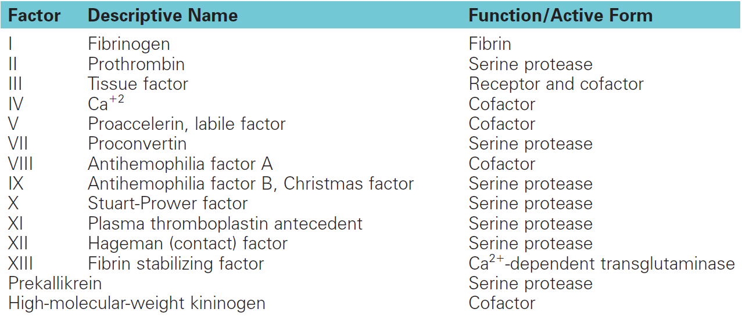
Coagulation factors

Slide 5
Regulatory proteins

Slide 6
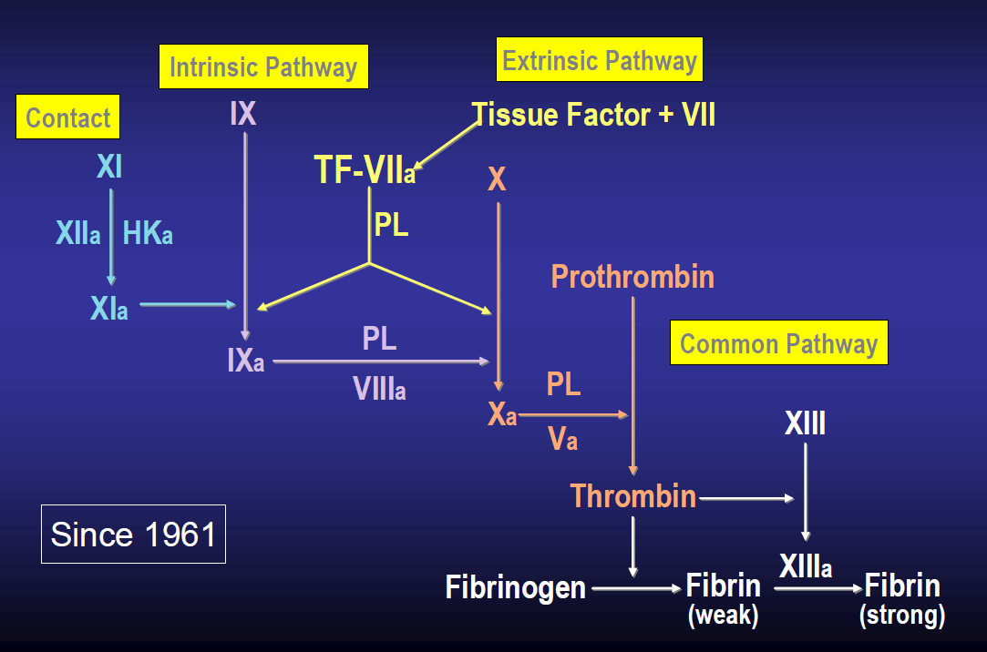
Classic-test tube coagulation cascade

Slide 7
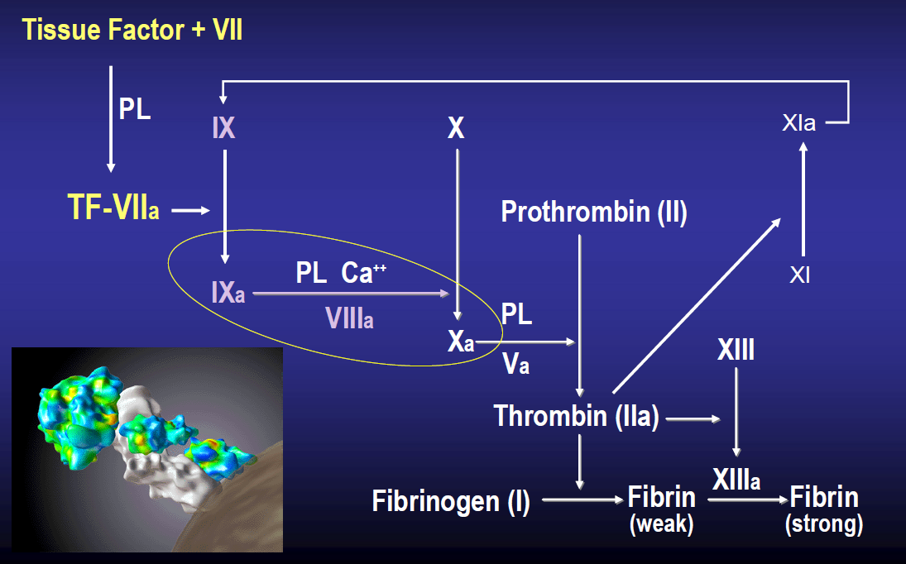
Coagulation cascade in vivo

Slide 8
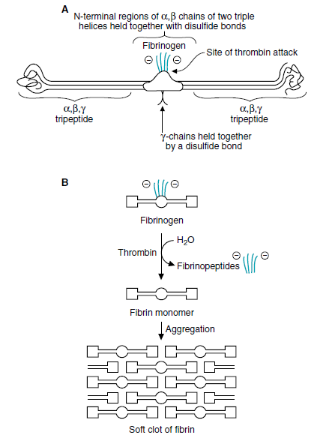
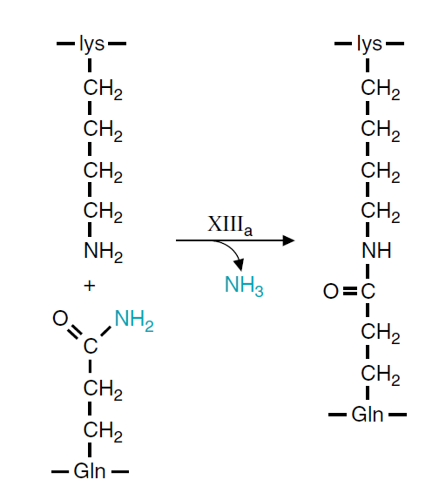
Formation of fibrin clot

Slide 9
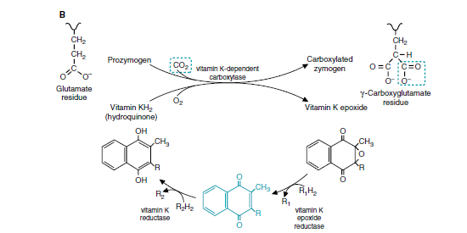
Effect of Warfarin
Warfarin
Warfarin

Slide 10
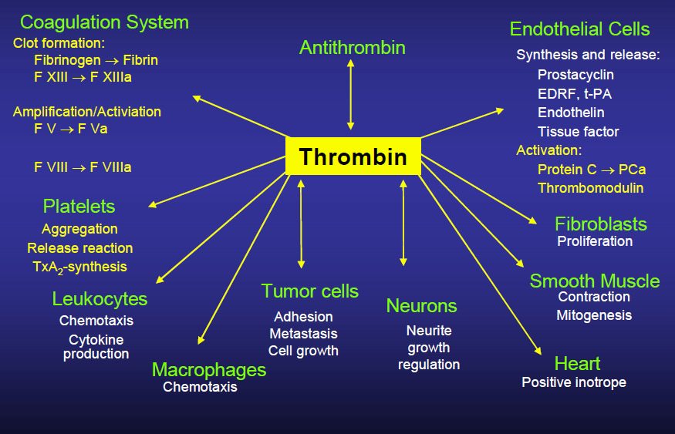
Thrombin roles

Slide 11
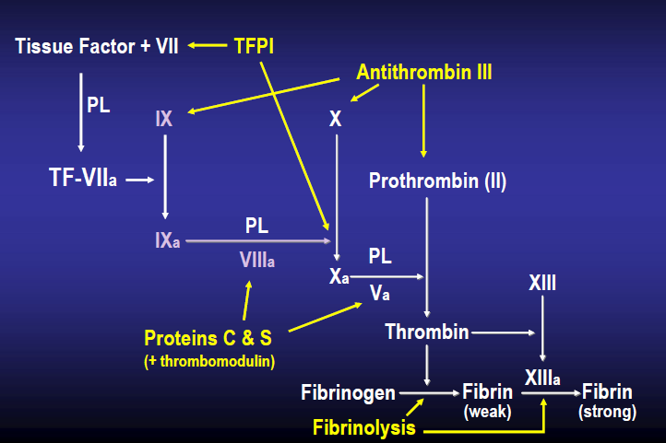
Physiologic anticoagulants

Slide 12
Fibrinolysis
Clotting Cascade
Fibrinogen
Fibrin-clot
Fibrin
degradation products
Plasminogen
Plasmin
T-PA
F XIIa
HMWK
Kallikrein
Urokinase
Streptokinase

Slide 13
Laboratory methods
Thrombocytes count
Bleeding time (Duke)
Prothrombine time (Quick’s test)
aPTT
Thrombin time

Slide 14
Thrombocytes count
200 – 400 x 103/µL (109/L) = 200 000 – 400 000 /µL
Low risk of spontaneous bleeding, in case of thrombocytes count > 30 000 /µL (endothelium and plasma coagulation system being intact)

Slide 15
Bleeding time
Ivy method: is the traditional format for this test. In the Ivy method, a blood pressure cuff is placed on the upper arm and inflated. A lancet or scalpel blade is used to make a stab wound on the underside of the forearm. The time from when the stab wound is made until all bleeding has stopped is measured and is called the bleeding time. Every 30 seconds, filter paper or a paper towel is used to draw off the blood. The test is finished when bleeding has stopped completely.
Template method: a template is placed over the area to be stabbed and two incisions are made in the forearm using the template as a location guide.
Duke method: a nick is made in an ear lobe or a fingertip is pricked to cause bleeding.
A normal bleeding time for the Ivy method is less than five minutes from the time of the stab, 3 minutes for Duke method

Slide 16
Protrombin Time (Quick’s test)
Prothrombin Time (PT)
  Plasma + Calcium + Tissue Thromboplastin
  TF + VIIa → Xa + V → IIa → CLOT
PT only elevated
  Factor VII deficiency
  Congenital (very rare)
  Acquired (Vit K deficiency, liver disease)
  Factor VII inhibitor
  Rarely in pts with modest decreases of factor V or X

Slide 17
aPTT
Activated Partial Thromboplastin Time (aPTT)
  Plasma + Calcium + Kaolin + Phospholipids
  Contact → XIa → IXa + VIII →Xa + Va →IIa →CLOT
aPTT only elevated
  Factor XI, IX, or VIII deficiency
  Factor XI, IX, or VIII specific factor inhibitor
  Heparin contamination
  Antiphospholipid antibodies

Slide 18
Both PT-INR and aPTT are elevated
Factor(s) X, V, or II deficiency
Factor(s) X, V, or II inhibitor
Improper anticoagulation ratio (Hct >60 or <15)
High doses of heparin (↑ aPTT > ↑ PT-INR)
Large Warfarin effect ((↑ PT-INR > ↑ aPTT)
Low fibrinogen (<80 mg/dl)

Slide 19
Thrombin Clotting Time (TCT)
Add thrombin to patient’s plasma
  This should directly clot fibrinogen
Elevated in
  Heparin use
  DIC
  Dysfibrinogenemia
  Low fibrinogen levels
  High fibrinogen levels
  Uremia

Slide 20
Marks´ Basic Medical Biochemistry, A Clinical Approach, third edition, 2009 (M. Lieberman, A.D. Marks)
Color Atlas of Biochemistry (J. Koolman, K.H. Roehm)
Stanislav Matoušek:Patofyziologie koagulace,
Thomas A. Whitehill: Coagulation Made Simple

