Slide 1
Biochemistry of
free radicals,
oxidative stress
and aging
JAN ILLNER

Slide 2
Oxidative stress
● 1985, Sies:
Having too many reactive species (RS) in relation to the available antioxidants.
● 1991, Sies:
A disturbance in the prooxidant-antioxidant balance in favour of the former, leading to potential damage. oxidative damage
● 2004, Halliwell and Whiteman:
The biomolecular damage caused by attack of RS upon the constituents of living organisms.
● Not all damage caused by oxidative stress is oxidative damage!

Slide 3
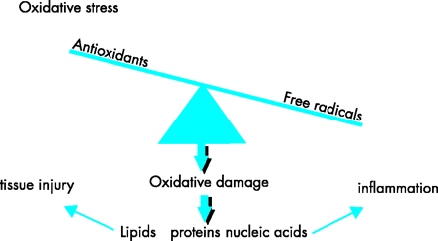
Oxidative stress
Ischemia-reperfusion
Hypoxia
Hyperoxia
Heat
Radiation
Toxins
Excercise to excess
Infection
Trauma
Frank J Kelly. Oxidative stress: its role in air pollution and adverse health effects. Occup Environ Med2003;60:612-616
● increased ROS production
● impaired and insufficient antioxidative defence
damage to biomolecules

Slide 4
Free radicals
A free radical is any species capable of independent
existence that contains one or more unpaired electrons
● designation: R●
● to be paramagnetic
● renowned for their high chemical reactivity
Forming: X − e⁻ X^{●+} (oxidation)
Y + e⁻ Y^{●−} (reduction)
Homolytic fission of a covalent bond
A : B A● + B●

Slide 5
Free radical reactions
Free radicals easily react with a biological molecules (mainly
non-radicals) generating new radicals – initiate chain reactions
Types of radical reaction:
○ reactions between two radicals (NO^{●−} + O₂^{●−} ONOO⁻)
○ radical addition on to another molecule
(addition of OH● to guanine in DNA)
○ oxidation and reduction of non-radicals
○ abstraction of a hydrogen atom from C–H bond (fatty acids)

Slide 6
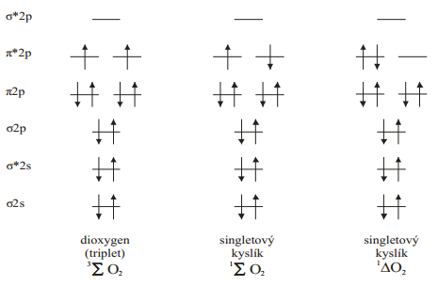
Reactive species
Oxygen is a biradical – it has two unpaired electrons
triplet dioxygen
singlet oxygen
singlet oxygen
Free radicals and non-radical species derived from oxygen are called
reactive oxygen species (ROS)
Similarly, reactive species containing nitrogen are called
reactive nitrogen species (RNS)

Slide 7

Reactive oxygen species
Reactive oxygen species | Symbol | Properties
superoxide radical | O₂^{•-} | weak oxidant
hydroperoxyl radical | HO₂• | stronger oxidant than O2-
hydrogen peroxide | H₂O₂ | oxidant
hydroxyl radical | OH• | extremely reactive
alcoxyl radical | RO• | less reactive than OH
peroxyl radical | ROO• | weaker oxidant
singlet oxygen | ¹O₂ | strong oxidant
other oxygen non-radical species: hypochlorous acid HOCl, ozone O₃, organic peroxides ROOH

Slide 8
Reactive nitrogen species
radicals:
non-radicals:
nitric oxide NO●
nitrogen dioxide NO₂●
peroxynitrite ONOO⁻
nitrous acid HNO₂
dinitrogen trioxide N₂O₃
nitronium NO₂⁺
nitrite NO₂⁻
nitrate NO₃⁻

Slide 9
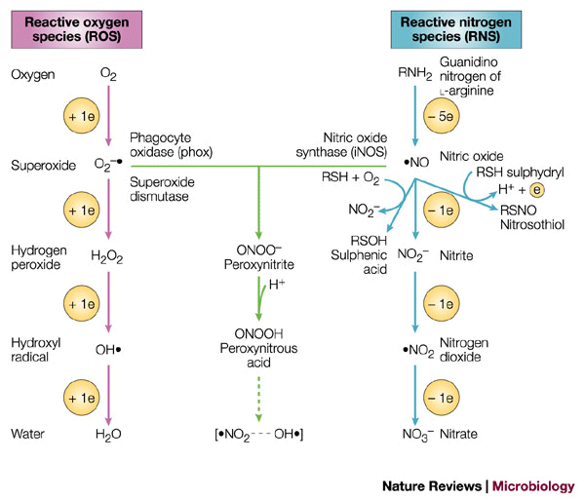
ROS/RNS reaction
http://www.nature.com/nrmicro/journal/v2/n10/fig_tab/nrmicro1004_F2.html

Slide 10
Sources of ROS/RNS in vivo
Mitochondria (electron transport chain)
Phagocytosis (NADPH oxidase, myeloperoxidase)
Xanthine oxidase (XO)
Nitric oxide synthase (NOS)
Cytochrome P450
Oxidation of arachidonic acid (lipoxygenase, cyclooxygenase)
Non-enzymatic reactions

Slide 11
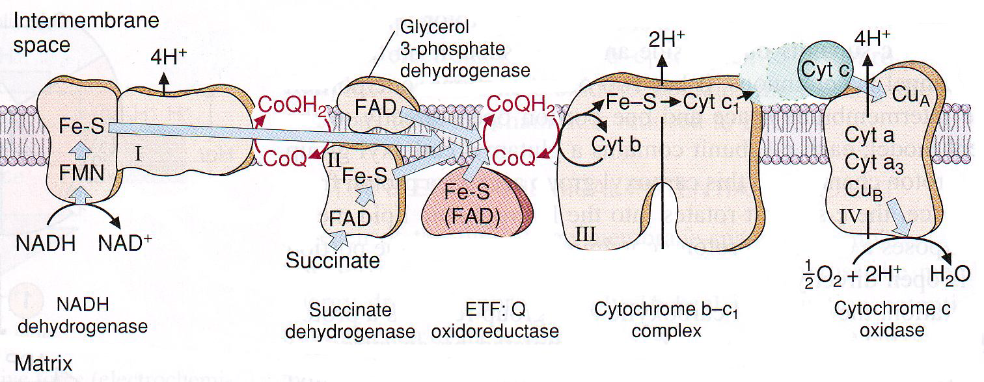
1. Mitochondria
Mitochondrial electron transport chain complexes I, II and III take part in O₂^{●−} production
Importance of coenzyme Q semiquinone radical!
O₂
O₂
O₂^{●−}
O₂^{●−}
O₂
O₂^{●−}

Slide 12
Mitochondria
● one of the most important sources of ROS production
● complexes of ETC can catalyse one electron reduction of O₂
to superoxide
● cytochrome c oxidase produces radical intermediates, although
they are firmly bound to the enzyme
● NADH dehydrogenase (complex I) and cytochrome bc₁
(complex III) are major sites of superoxide production
● electron carrier coenzyme Q (ubiquinone) is during electron
transport oxidized and afterwards reduced by single electron
forming radical intermediate (semiquinone) and it can react with
O₂ to give superoxide O₂^{●−}

Slide 13
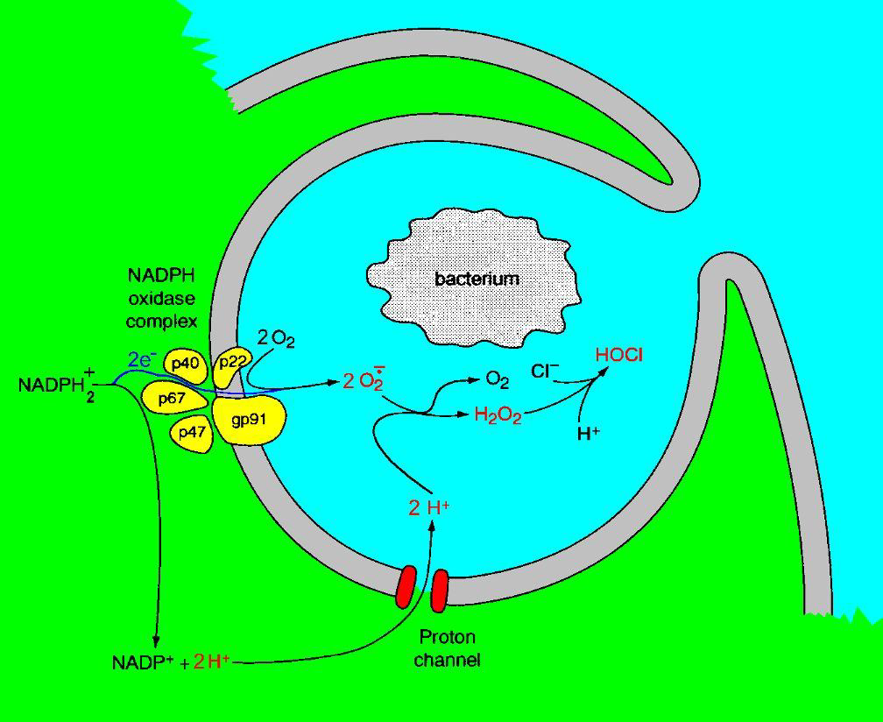
2. Phagocytosis
A rapid increase in O₂ consumption during phagocytosis is followed by ROS production – RESPIRATORY BURST
Enzymes: NADPH oxidase, myeloperoxidase
Figure downloaded from: http://tomonthetrib.wordpress.com/2007/09/20/proton-channels-areinstrumental-
in-the-respiratory-burst-of-phagocytosis/
1. NADPH + 2 O₂ → NADP⁺ + H⁺ + 2 O₂^{•-}
myeloperoxidase
2. 2 O₂^{•-} + 2 H⁺ → O₂ + H₂O₂
3. H₂O₂ + Cl⁻ + H⁺ → HOCl + H₂O

Slide 14
Phagocytosis
● phagocytes (neutrophils, macrophages) ingest bacteria as a part
of immune system response to inflammation
● a step increase in O₂ consumption in phagocytosis is observed –
respiratory burst
● enzymes that catalyse ROS production are activated (NADPH
oxidase)
● superoxide is produced in a reaction catalysed by NADPH
oxidase, and afterwards it dismutates to hydrogen peroxide
● hydrogen peroxide reacts with Cl⁻ and hypochlourous acid
(HOCl) is produced – it is catalysed by myeloperoxidase
● HOCl and other ROS are lethal for bacteria

Slide 15
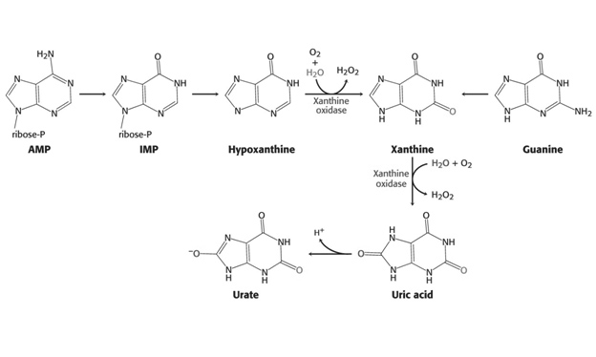
3. Xanthine oxidase (XO)
Xanthine dehydrogenase (XDH), which uses NAD⁺ as an electron acceptor, is oxidatively modified (its –SH groups oxidized) and transformed to XO (uses O₂)

Slide 16
Xanthine oxidase (XO)
● adenine is metabolized to hypoxanthine and consequently to
xanthine, while guanine is metabolized to xanthine, which is
metabolized (oxidized) to uric acid
● reactions in which both xanthine and uric acid are products are
normally catalysed by xanthine dehydrogenase (XDH)
● XDH uses NAD⁺ to oxidize hypoxanthine and/or xanthine
● during tissue damage (caused by oxidative stress), XDH may be
modified (oxidation of its thiol groups and partial proteolysis) to
xanthine oxidase
● xanthine oxidase uses O₂ for oxidation of hypoxanthine and
xanthine generating superoxide radicals
● superoxide radicals undergo spontaneous dismutation which gives
hydrogen peroxide

Slide 17
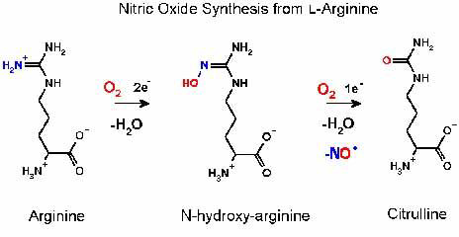

4. Nitric oxide synthase (NOS)
Three isoforms of NOS: endothelial (eNOS)
inducible (iNOS)
neuronal (nNOS)
NITRIC OXIDE
http://www.homepages.ed.ac.uk/sd01/nospage.htm

Slide 18
Nitric oxide synthase (NOS)
endothelial (eNOS)
neuronal (nNOS)
inducible (iNOS)
produce low NO amount needed for cell signalling
produce high and toxic NO concentrations
its activity is not regulated by Ca²⁺, but is regulated by gene transcription
NOS catalyse NO● production from L-arginine
various NOS isoforms are named after a tissue they were originally
found

Slide 19
Nitric oxide
● NO● is a very important cellular signalling molecule
– vasodilator, neurotransmitter, mediator of immune response
● NO● is a precursor of other RNS (peroxynitrite, NO₂) and is also
linked to pathological modifications of cellular components
● NO● binds to haeme in cytochromes and haemoglobin

Slide 20
Non-enzymatic reactions
Fenton reaction: Fe²⁺ + H₂O₂ Fe³⁺ + OH● + OH⁻
Haber-Weiss reaction: O₂^{●−} + H₂O₂ O₂ + OH● + OH⁻
Peroxynitrite production: O₂^{●−} + NO● ONOO⁻
OH● is an extremely reactive species and causes damage to various biomolecule!
ONOO⁻ is a very powerful oxidizing and nitrating agent
Fe²⁺

Slide 21
Haemoglobin autooxidation:
Hb-Fe²⁺ − O₂ O₂^{●−} + metHb-Fe³⁺
Ionizing radiation and ultrasound generate OH●
Glycooxidation – non-enzymatic reaction of saccharide (glucose, fructose) with proteins, lipids and DNA is called glycation
Glycation products can be oxidized – advanced glycation
end-products (AGEs)
AGEs cause more oxidative stress

Slide 22
Effect of ROS/RNS on cells
PROTEINS
oxidation
nitration
damage and loss of function
(enzymes and other proteins)
DNA
chemical changes in bases
DNA damage
mutations
ROS/RNS
LIPIDS
lipid peroxidation
(polyunsaturated fatty acids)
membrane damage

Slide 23
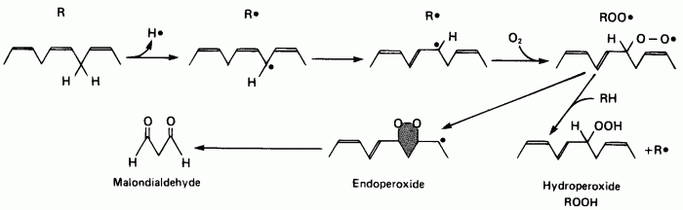
Lipid peroxidation
Peroxyl radical
Figure downloaded from: http://www.benbest.com/lifeext/aging.html
● PUFA (arachidonic acid) are highly susceptible to peroxidation
● hydrogen is abstracted (by OH●) from methylene group and carbon-centred
radical is generated
● carbon-centred radicals of PUFA react easily with O₂ yielding peroxyl
radical (ROO●)
● peroxyl radical can attact another molecule of PUFA propagating thus LP
lipid(hydro)peroxide and new carbon-centred PUFA radical are products
● lipidperoxides can decompose to very reactive aldehydes (malondialdehyde,
4-hydroxynonenal)

Slide 24
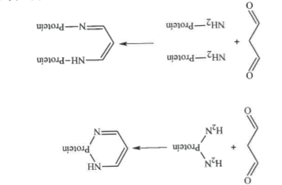
MDA can reacts with free amino groups of proteins forming protein complexes that are not functional

Slide 25
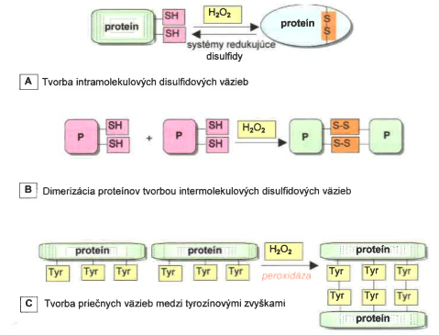
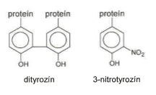
Protein oxidative modification
disulfide reduce systems
Intramolecular disulphidic bonds formation
Protein dimerisation by intramolecular disulphide bonds formation
Crosslinking formation among tyrosine residues
dityrosine 3-nitrotyrosine

Slide 26
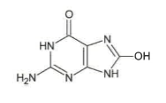
DNA oxidative damage
8-hydroxyguanine
Free radicals can react with structural units of DNA and can damage purine and pyrimidine bases and deoxyribose as well.
Reactive nitrogen species can cause deamination and nitration of purine bases.
8-hydroxyguanine is produced after addition of OH• to C8 of guanine.

Slide 27
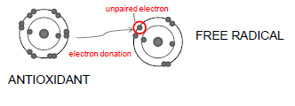
Antioxidative defense
An antioxidant is any substance that delays, prevents or removes oxidative damage to a target molecule
There is no universal best antioxidant!
Their relative importance depends upon:
Which, how, where ROS is generated and what target of damage is measured

Slide 28
Antioxidative defense
● enzymes – catalytically remove ROS
(superoxide dismutase, catalase, glutathione peroxidase,
peroxiredoxins)
● proteins that remove pro-oxidants (metal ions and haeme)
(transferrin, ferritin, albumin, haptoglobin, ceruloplasmin)
● low-molecular weight substances („sacrificial agents“)
○ synthesized in vivo (bilirubin, uric acid, lipoic acid, coenzyme Q)
○ from the diet (vitamins E and C, carotenoids, plant phenols)

Slide 29
● superoxide dismutase – catalyses dismutation of superoxide
to oxygen and hydrogen peroxide
● catalase – catalyses dismutation of hydrogen peroxide to
oxygen and water
● glutathione peroxidase – catalyses reduction of hydrogen
peroxide to water using reduced glutathione
– consists of four subunits, each subunit
contains Se in active site

Slide 30
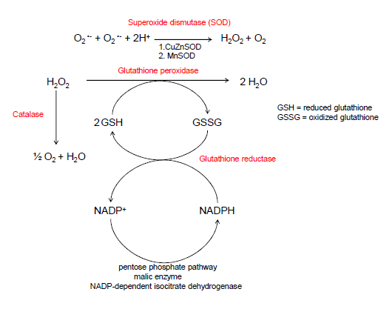

Slide 31
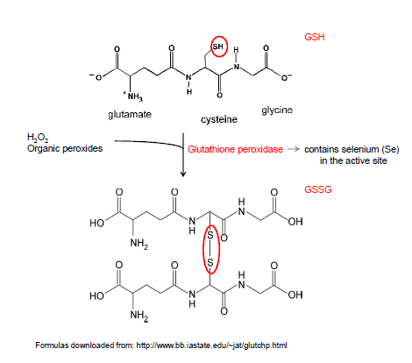

Slide 32
Glutathione
● regulates ascorbate metabolism
● maintains communication between cells through gap junctions
● prevents protein −SH group from oxidizing
● mM concentration in various tissues (99% as GSH)
● highest levels in liver, kidney and lens
● a direct scavenger of ROS (OH●, ONOO⁻)
● red blood cells are particularly dependent on GSH antioxidative
defence for their normal function

Slide 33
● peroxiredoxins – catalyse reduction of hydrogen peroxide and
organic peroxides
– cystein residues are present in active site
● thioredoxins – reduce oxidized peroxiredoxins, hence regenerate
them
– polypeptides of relative M_{r} ~ 12 kDa
– two cystein residues

Slide 34
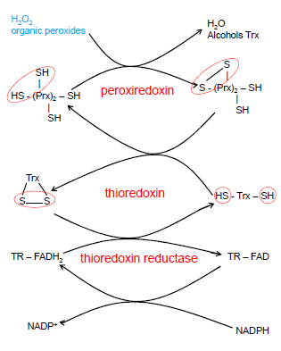

Slide 35
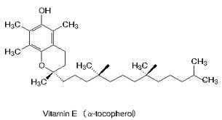
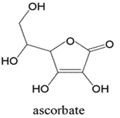
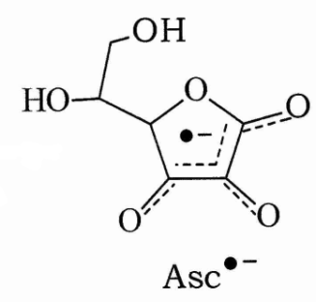
Dietary antioxidants
Vitamin E (α-tocopherol)
○ lipophilic structure
○ inhibitor of lipid peroxidation in cellular membranes
α-TocH + LOO● → α-Toc● + LOOH
Vitamin C (ascorbic acid)
○ soluble in water
○ regenerates vitamin E in membrane
α-Toc● + → α-TocH +

Slide 36
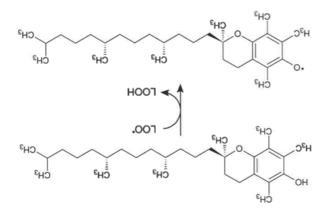
Vitamin E metabolism
The aim of vitamin E: termination of lipid peroxidation
Vitamin E changes peroxyl radicals in lipid peroxides and changes in tocopheryl radical itself

Slide 37
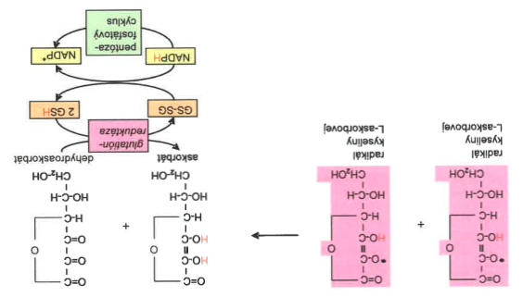
Vitamin C metabolism
Ascorbic
Radical
Ascorbate
Dehydroascorbate
Ascorbic
Radical
Glutathione
reductase
Pentose
phosphate
pathway
Dismutation of ascorbic radicals (not so reactive).
Oxidized dehydroascorbate is reduced back to ascorbate by GSH and NADPH.

Slide 38
Assessment of oxidative stress
● direct measurement of reactive species – trapping
● biomarker measurement (markers of oxidative damage to
biological material) – fingerprinting/footprinting
○ biomarkers of oxidative DNA damage
→ 8-hydroxy-2´-deoxyguanosine (8OHdG)
○ biomarkers of lipid peroxidation
→ end-products: peroxides, isoprostanes, aldehydes,
fluorescent pigments
○ biomarkers of protein damage
→ protein carbonyls, dityrosine, nitrotyrosine, oxidized −SH
groups

Slide 39
Cell injury (damage to biomolecules) is one of the consequences of oxidative stress
○ increased proliferation (by low-level stress)
○ adaptation (mild to moderate stress can result in increased
synthesis of antioxidant defense; ischemic preconditioning)
○ aging (by high-level stress)
○ cell death (apoptosis, necrosis)
○ changes in cellular ion metabolism (↑ intracellular Ca²⁺, release
Fe, Cu )

Slide 40
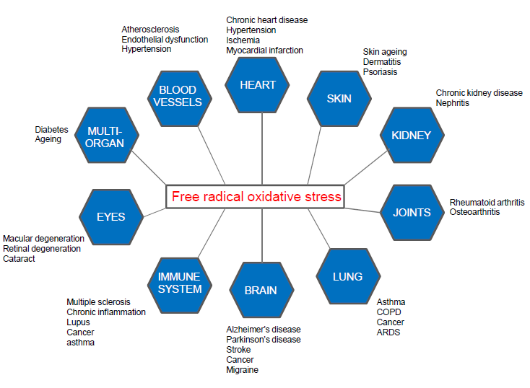

Slide 41
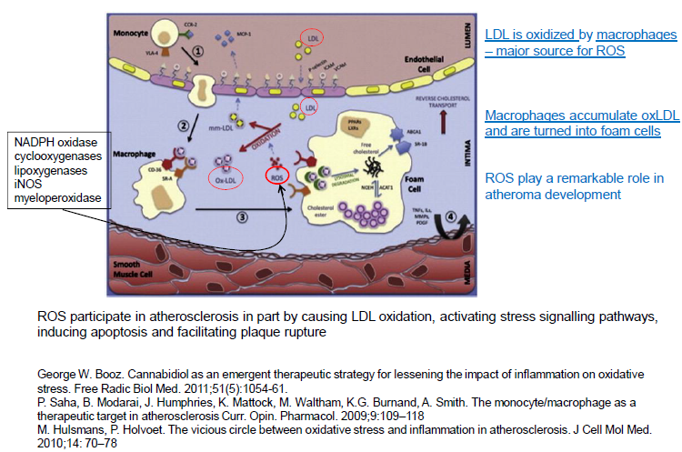
ROS and atherosclerosis

Slide 42
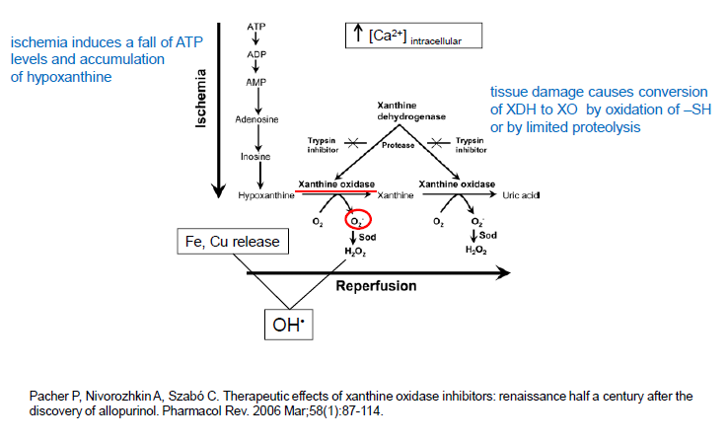
ROS and ischemia -reperfusion

Slide 43
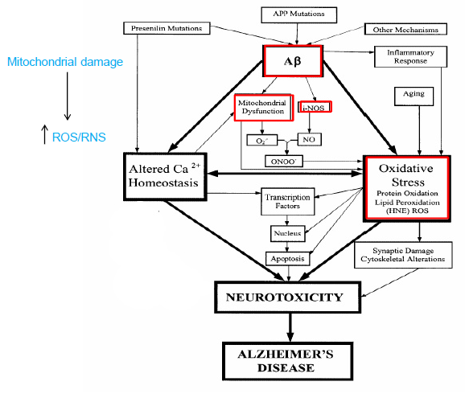
ROS and neurodegerative disorders (Alzheimer´s disease)

Slide 44
Summary
Free radicals can cause cellular damage as well as they can be beneficial for organism in certain situations
Various sorces of free radicals in organism
Antioxidants and antioxidative defense
Diseases linked with oxidative stress

Slide 45
Literature
Barry Halliwell and John M. C. Gutteridge; Free Radicals in Biology and Medicine; fourth edition (2007); Oxford University Press, Inc.
R. K. Murray et all., Harper s Illustrated Biochemistry, 28th edition (2009), The McGraw-Hill Companies, Inc.
D. Dobrota et all., Lekárska biochémia, first edition (2012), Osveta Publishing
M. Kalousová et all., Patobiochemie ve schématech, first edition (2006), Grada Publishing

Slide 46
Thank you for attention!
Time for your questions…

