Slide 1
Biochemistry of CNS
Alice Skoumalová, Bruno Sopko

Slide 2
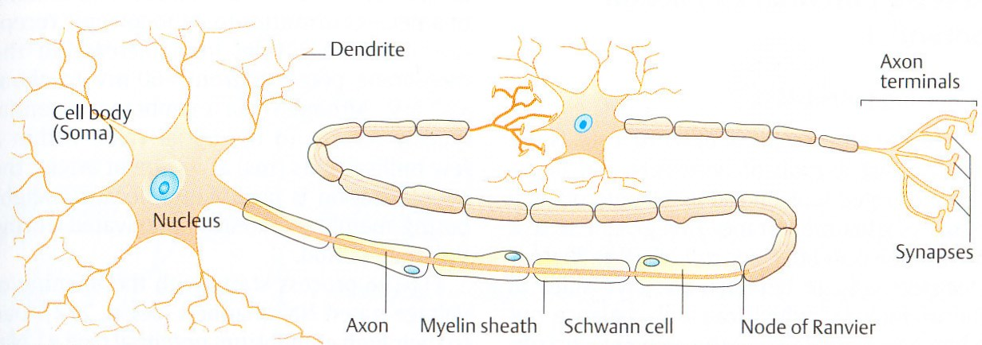
Structure of nerve cells
1. Neurons (a cell body , axons, dendrites, synapses)
    Signal transmission
    Neurotransmitters, receptors
    Terminally differentiated cells, little capacity for division, apoptosis
2. Glial cells
  Astrocytes (phagocytosis, lactate, regulation of the content of ECF)
  Oligodentrocytes (provide the myelin sheath in the CNS)
  Schwann cells (form myelin sheaths in the PNS)
  Microglial cells (protective role)
  Ependymal cells (production of CSF, neuron regeneration)

Slide 3
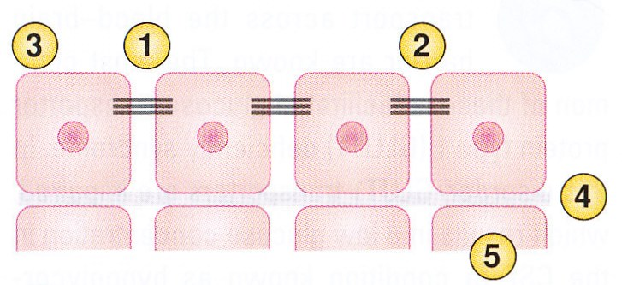
The blood-brain barrier (BBB)
The structure of the BBB:
1. Tight junctions
2. Narrow intercellular spaces
3. Lack of pinocytosis
4. Continuous basement membrane
5. Astrocytes
Transport through the BBB:
A. Fuels
Glucose (GLUT-1, GLUT-3)
Lactate, acetate, pyruvate, ketone bodies (specific transporters)
B. Amino acids and vitamins
Phe, Leu, Tyr, Ile, Val, Trp, Met, His (an amino acid transporter)
Ala, Gly, Pro, GABA (restricted entry to the CNS)
Vitamins (transporters)
C. Receptor-mediated transcytosis
Insulin, transferrin, IL-GF

Slide 4
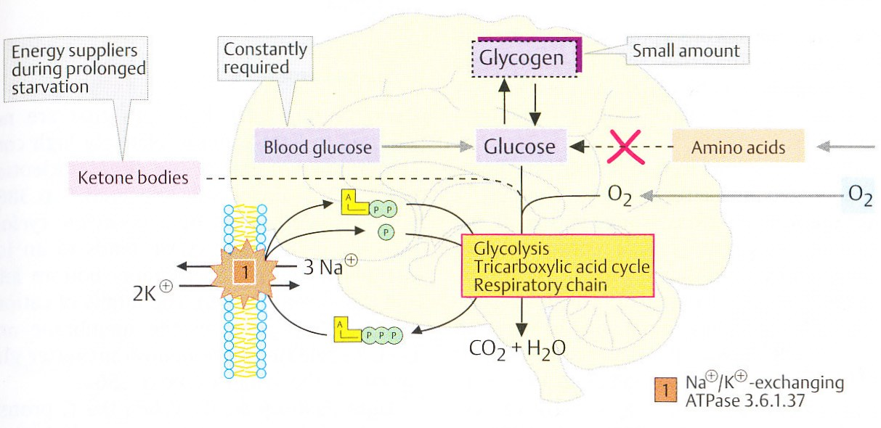
Energy metabolism of the brain
Brain:
  High ATP requirements (20% of O₂, 60% of glucose)
  ATP-dependent ion pumps
  aerobic glycolysis (lipids do not cross the BBB, the amino acid entry is restricted)
  Ketone bodies are oxidized during starvation

Slide 5
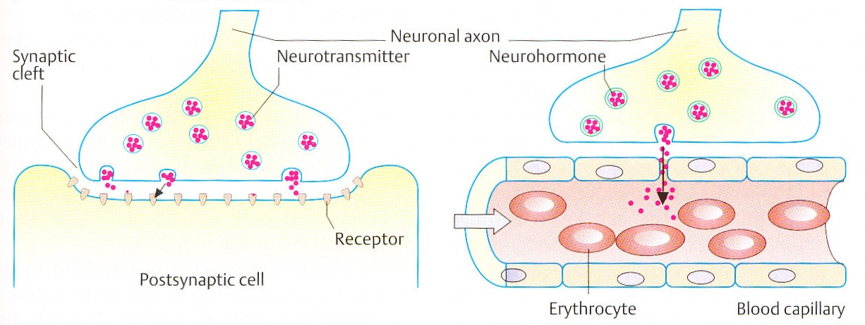
Neurosecretions:
Neurotrasmitters x Neurohormones
  released into the synaptic cleft
  influence neighboring cells
  a short lifespan
released into the blood
cover large distances
a longer lifespan
Notes:
Nervová buňka – excitovatelná buňka, která produkuje elektrický signál a reaguje na takový signál. Struktura – buněčné tělo, dendrity, axony.
Synapse – přenos signálu, spojení nervových buněk navzájem, či se svalovými buňkami.
Neurotransmitery – uvolňovány do synaptické štěrbiny a ovlivňují sousední buňky, krátká životnost
Neurohormony – uvolňovány do krve, působí na vzdálených místech

Slide 6
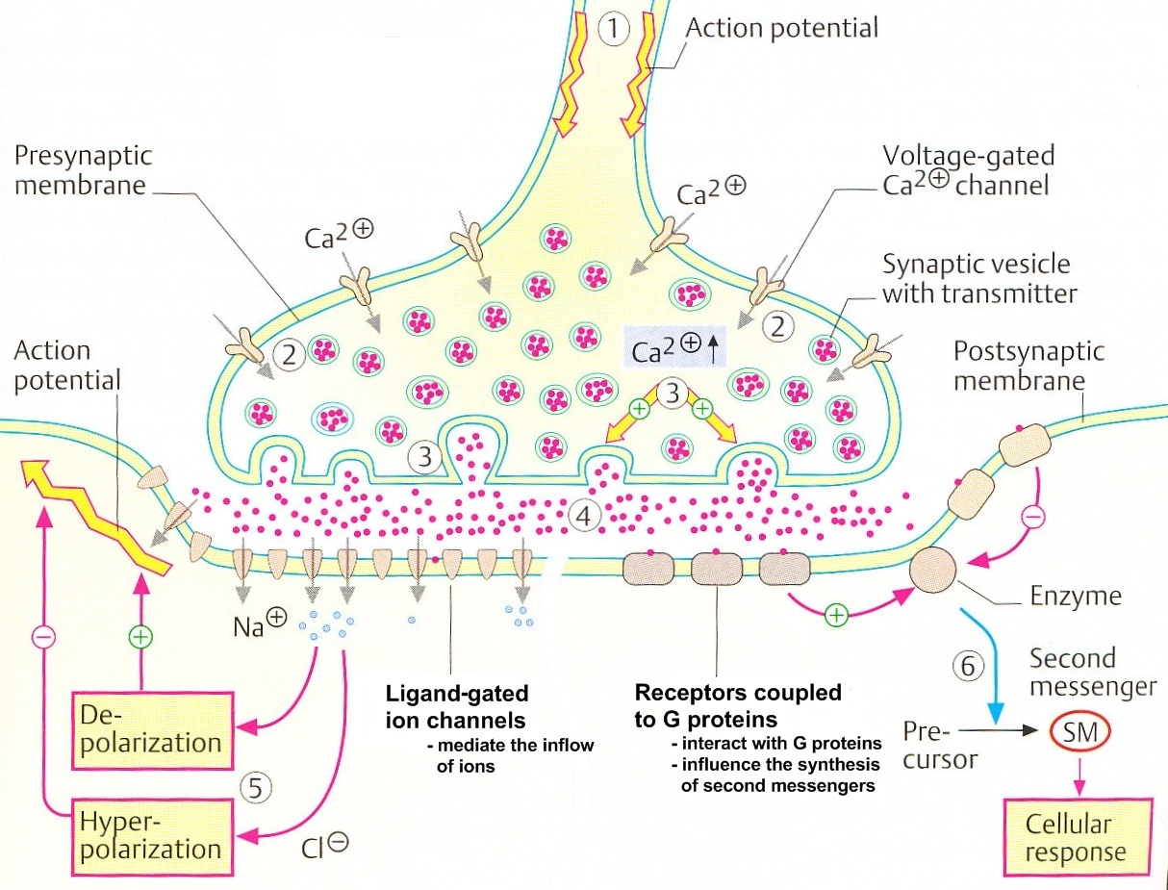
Synaptic signal transmission

Slide 7
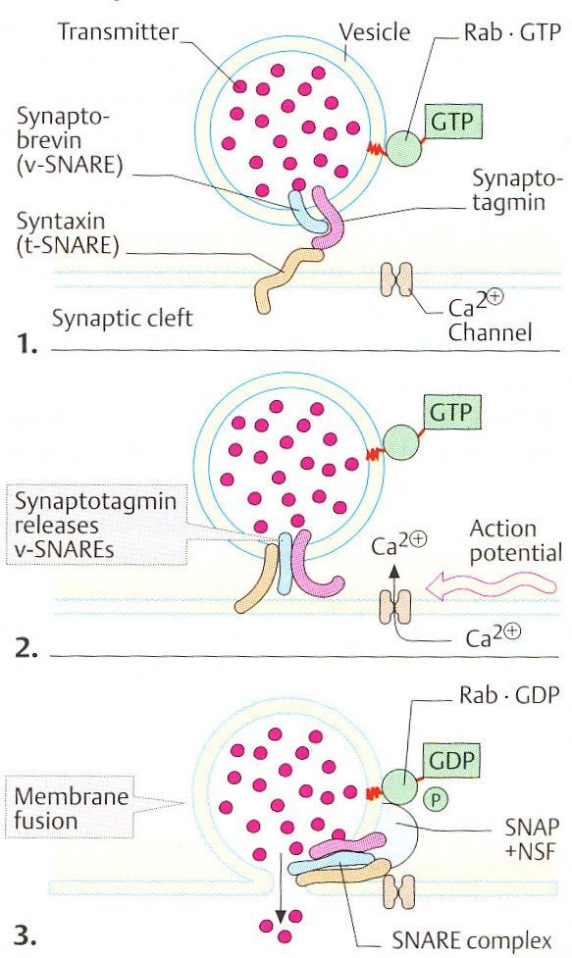
Exocytosis
process that allow cells to expel substances (neurotransmitters, hormones)
secretory vesicles fuse with plasma membrane and release their contens
regulated by chemical or electrical signals
The resting state (synaptobrevin is blocked)
Voltage-gated Ca²⁺ channels open - Ca²⁺ flow in – conformational changes in proteins
Membrane fusion (supported by the hydrolysis of GTP by Rab protein)
Botulotoxine: destroys components of the exocytosis in synapses through enzymatic hydrolysis

Slide 8
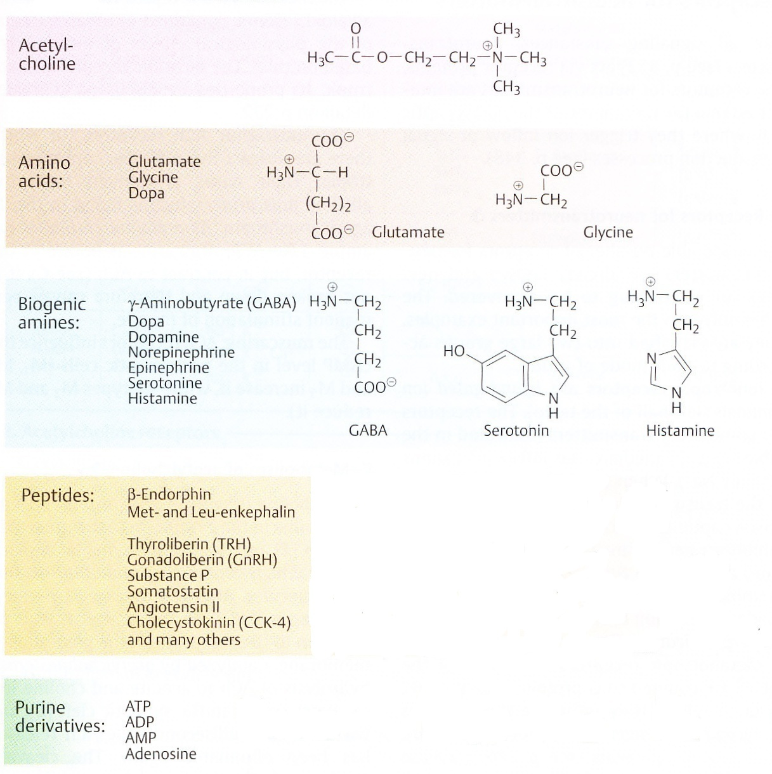

Slide 9
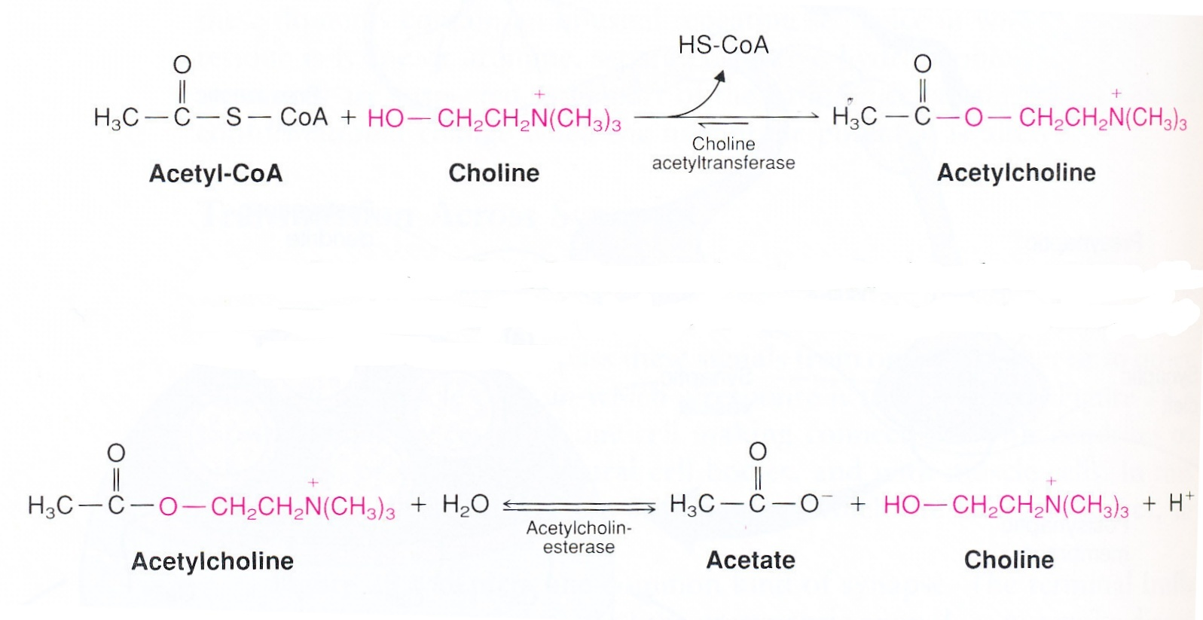
Metabolism of acetylcholine
- the transmitter of the parasympathetic and sympathetic system, at neuromuscular junctions, involved in learning and memory
1. The sythesis: from choline and acetyl-CoA in the neurons
2. Hydrolysis: in the synaptict cleft (restores the resting potential in the postsynaptic membrane)

Slide 10
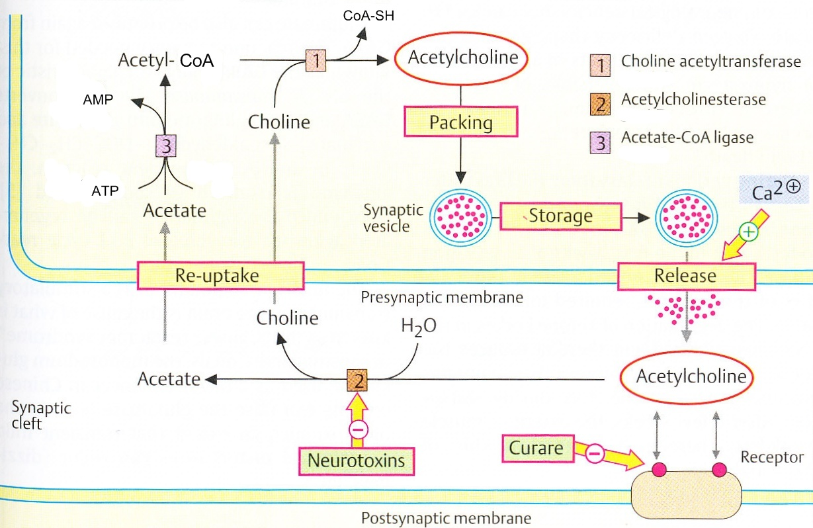

Slide 11
Acetylcholinesterase inhibitors
= inhibit acetylcholinesterase from breaking down acetylcholine, so increasing both the level and duration of action of the acetylcholine
Reverzible:
  therapeutic uses (myastenia gravis, Alzheimer disease)
  carbamates (physostigmine, neostigmine)
Irreverzible:
  have use as chemical weapons or pesticides
  organophosphates (soman, sarin)

Slide 12
Cholinergic synapses
Receptors | nicotinic | muscarinic
Mode of action | ion channel | G proteins: G_{P} G_{I}
Presence | the autonomic nervous system, neuromuscular junctions, adrenal medulla | brain, myocardium, smooth muscles, brain glands
Antagonists | tubocurarine | atropine

Slide 13
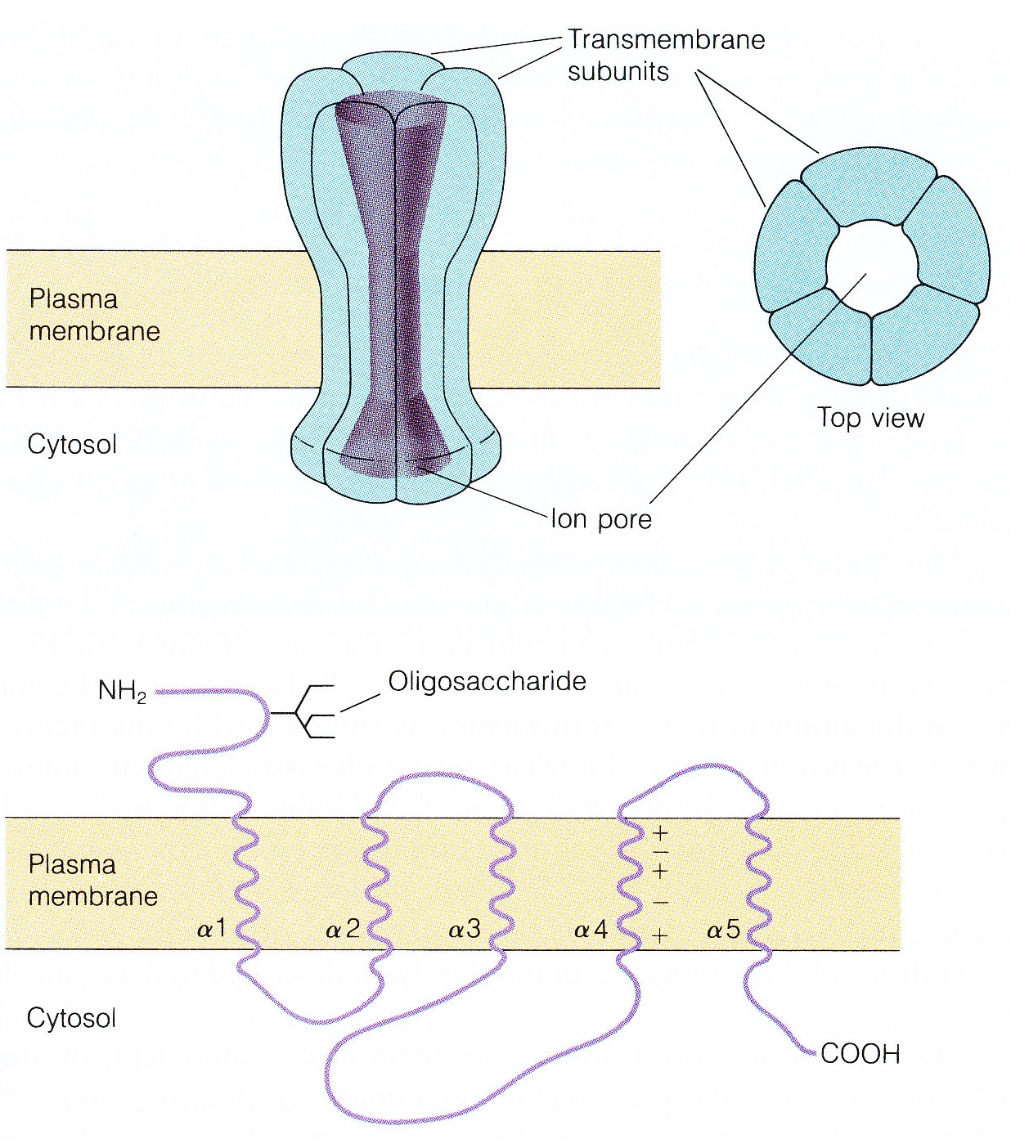
The nicotinic acetylcholine receptor
A transmembrane structure
- 5 subunits
- an ion por in the center
The sequence of the subunits
- 5 α-helixes traverse the membrane

Slide 14
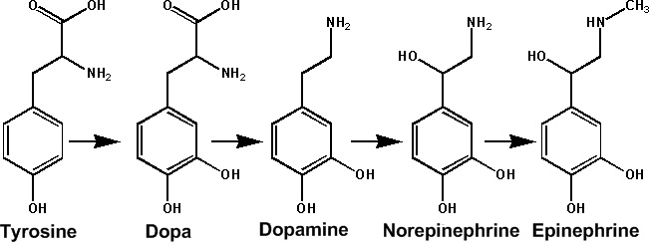
Metabolism of catecholamines
1.
2.
3.
4.
1
2
3
4
Hydroxylation of the aromatic ring: Tyrosine hydroxylase (tetrahydrobiopterin)
Decarboxylation of dopa: DOPA decarboxylase
Hydroxylation of dopamin: Dopamine β-hydroxylase (ascorbic acid)
N-methylation of norepinephrine: Phenylethanolamine N-methyltransferase (SAM)

Slide 15
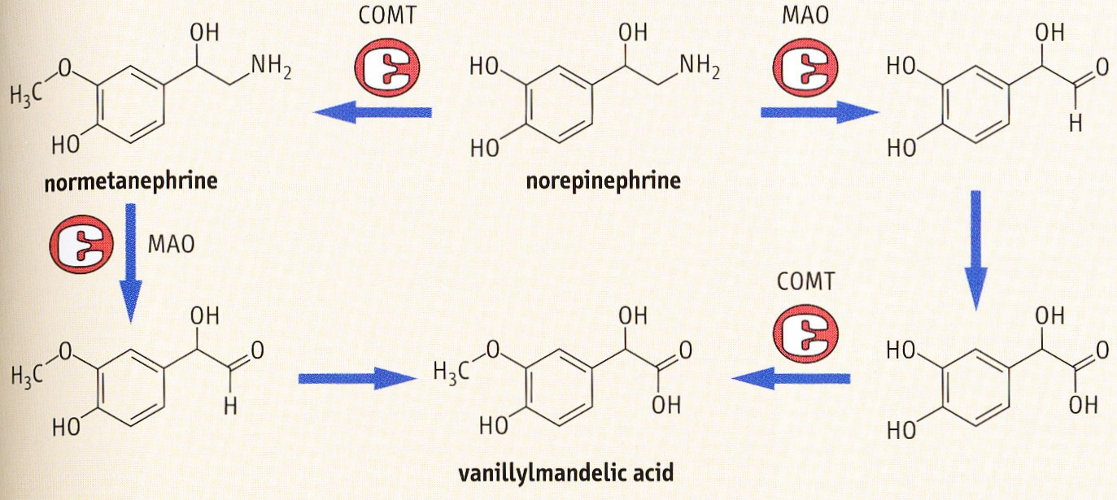
Catabolism of catecholamines
Clinical importance:
Pheochromocytoma:hypertension
metanephrines and vanillylmandelic acid in urine
Antidepressants: monoaminooxidase (MAO) inhibitors
SSRIs (specific serotonin reuptake inhibitors)

Slide 16
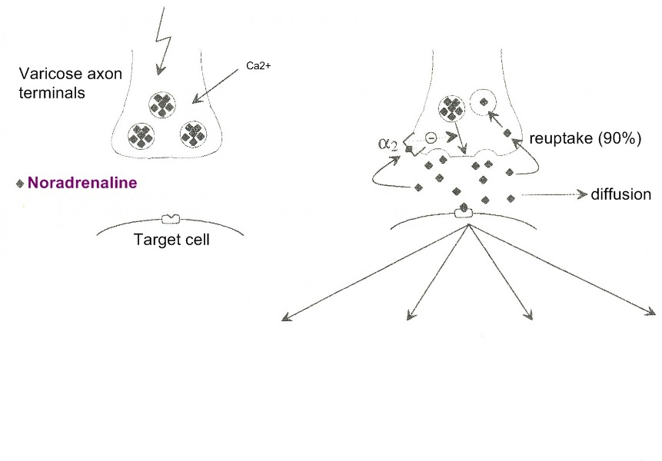
Adrenergic synapses
Receptors | α₁ | α₂ | β₁ | β₂
Mode of effect | G_{P} | G_{I} | G_{S} | G_{S}
Presence | smooth muscles in GIT (sphincters), scin vessels | pancreas | myocardium | smooth muscles in bronchi, GIT (peristalsis)

Slide 17
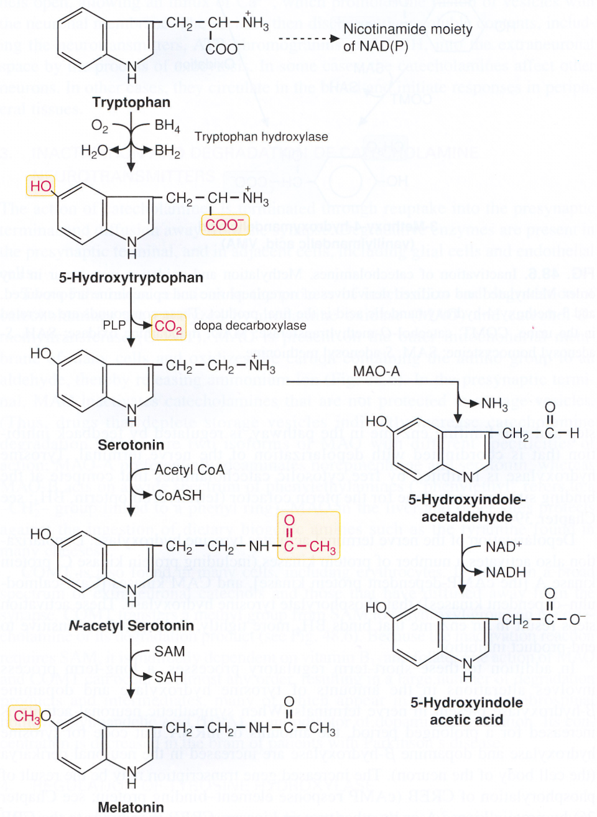
Metabolismu of serotonin
Synthesis
  Tryprophan hydroxylase (tetrahydrobiopterin)
  DOPA decarboxylase
Degradation
  MAO
The role of serotonin:
  The control of mood and appetite
  Vegetative behaviour
  Vasoconstriction
  Increased mobility of GIT

Slide 18
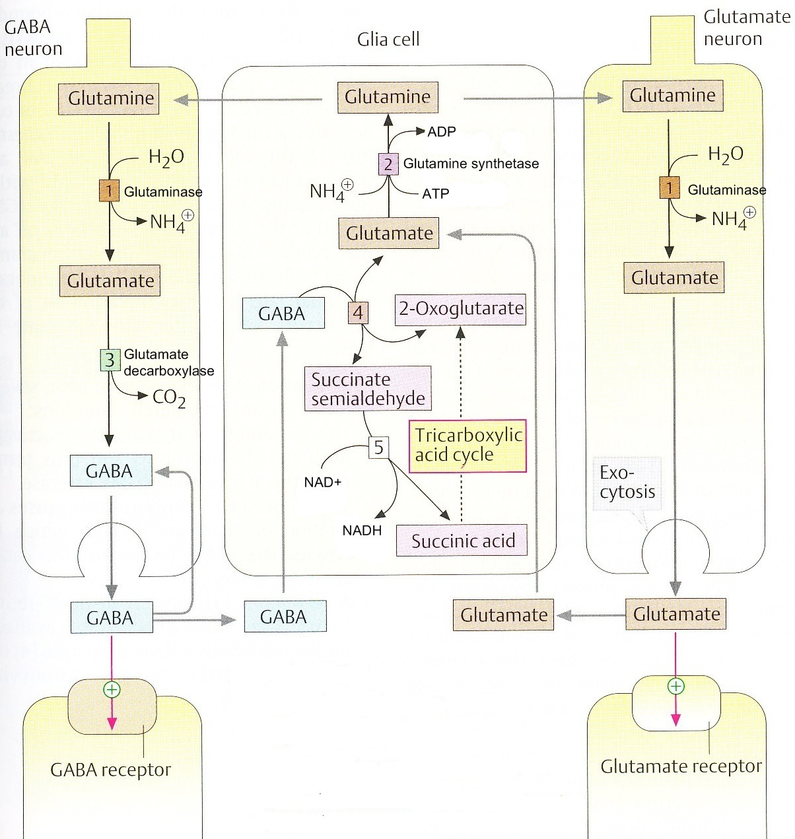
GABA, glutamate
-synthesis in neurons
-re-uptake
1. neuroglia supply with glutamine
2.hydrolysis of glutamine to glutamate
3.decarboxylation to GABA
Clinical importance: -glutamate excitotoxicity
-the Chinese restaurant syndrome (the monosodium glutamate – raise the glutamate level in the brain- neurological disturbances)

Slide 19
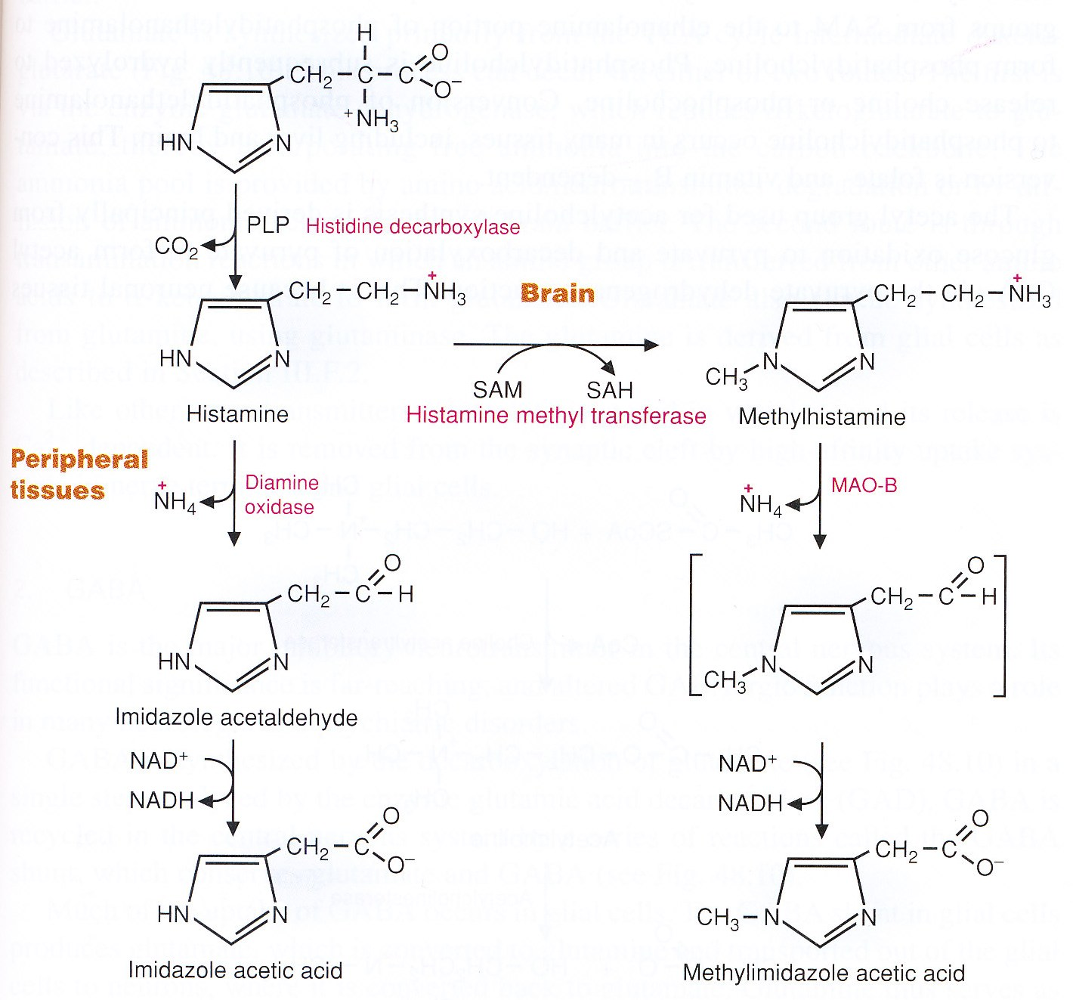
Metabolism of histamin
In brain produced by mastocytes and neurones (hypothalamus)
Stored in secretory vesicals
Specific receptors
Taken up by astrocytes (degradation)
The role in the CNS:
The release of pituitary hormones
Vigilance
Food intake

Slide 20
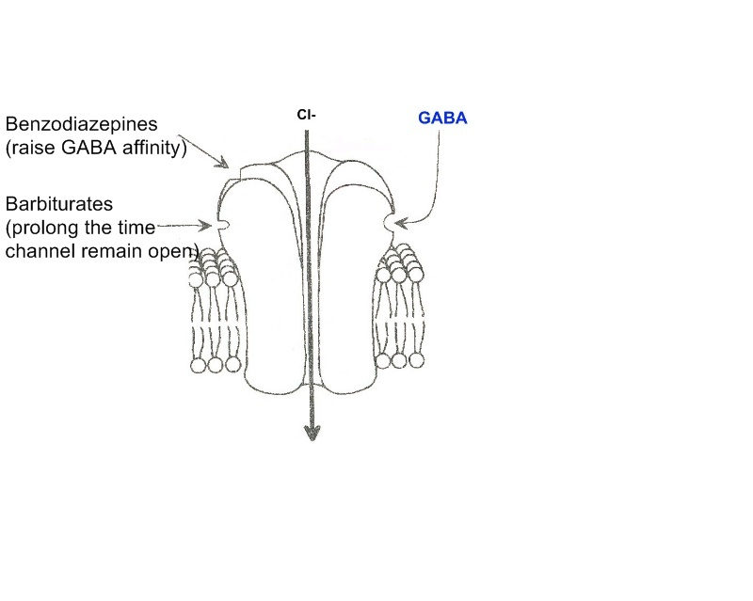
GABA_{A}-receptor
- brain, spinal cord
GABA binds to the receptor
Cl⁻ ions flow in
increase of the membrane´s resting potential (hinder the action of stimulatory transmitters)
= hyperpolarization

Slide 21
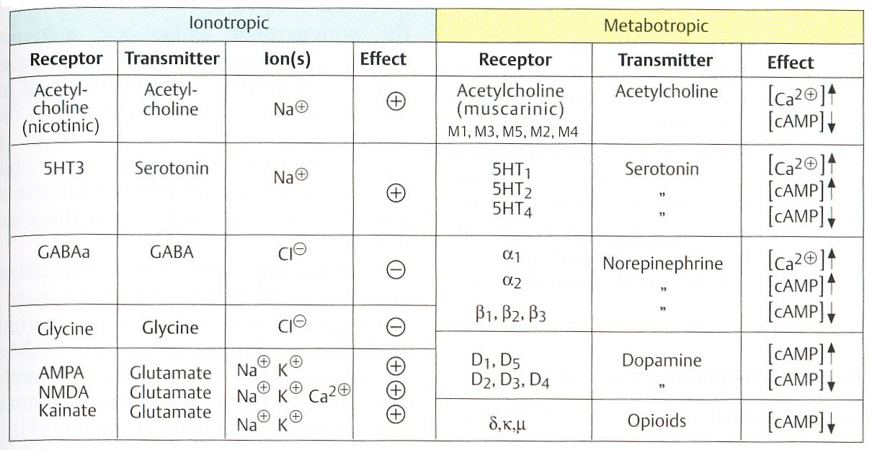
Receptors for neurotransmitters

Slide 22
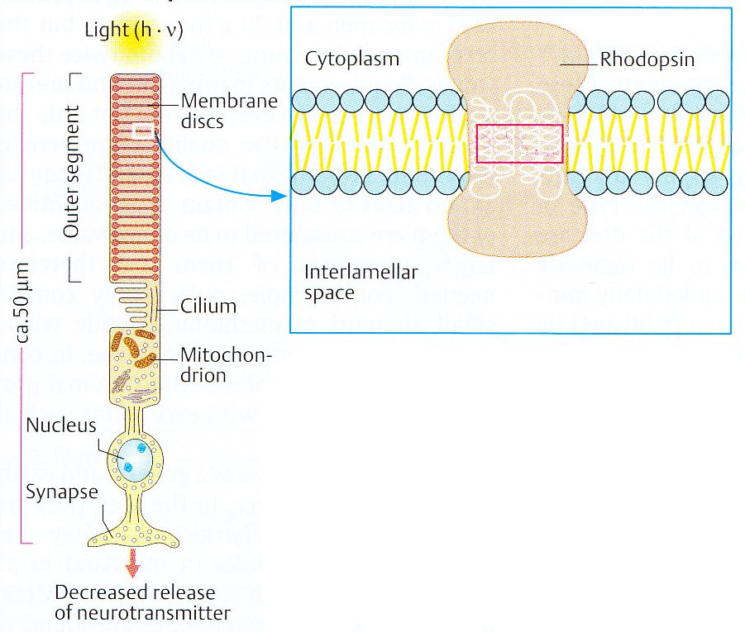
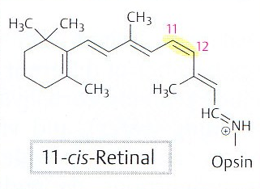
Sight
Two types of photoreceptors (rods and cones)
Rhodopsin (a chromoprotein):
  in the membrane discs of photoreceptors
  7 transmembrane α-helixes
  Retinal (aldehyde) + Opsin (Schiff base)

Slide 23
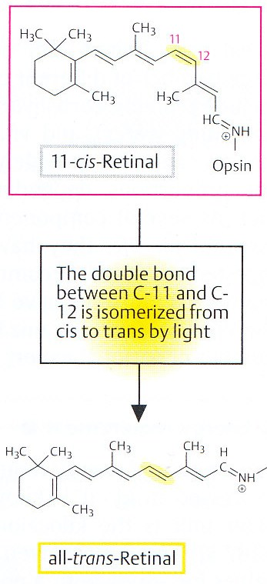
Cis-trans izomerization of retinal
The process of sight :
  light-induced cis-trans izomerization of retinal
  the conformational change of rhodopsin
  transducin (a G-protein) activates the enzyme
  that cleaves cGMP
  hyperpolarization and reduced releasing of glutamate

Slide 24
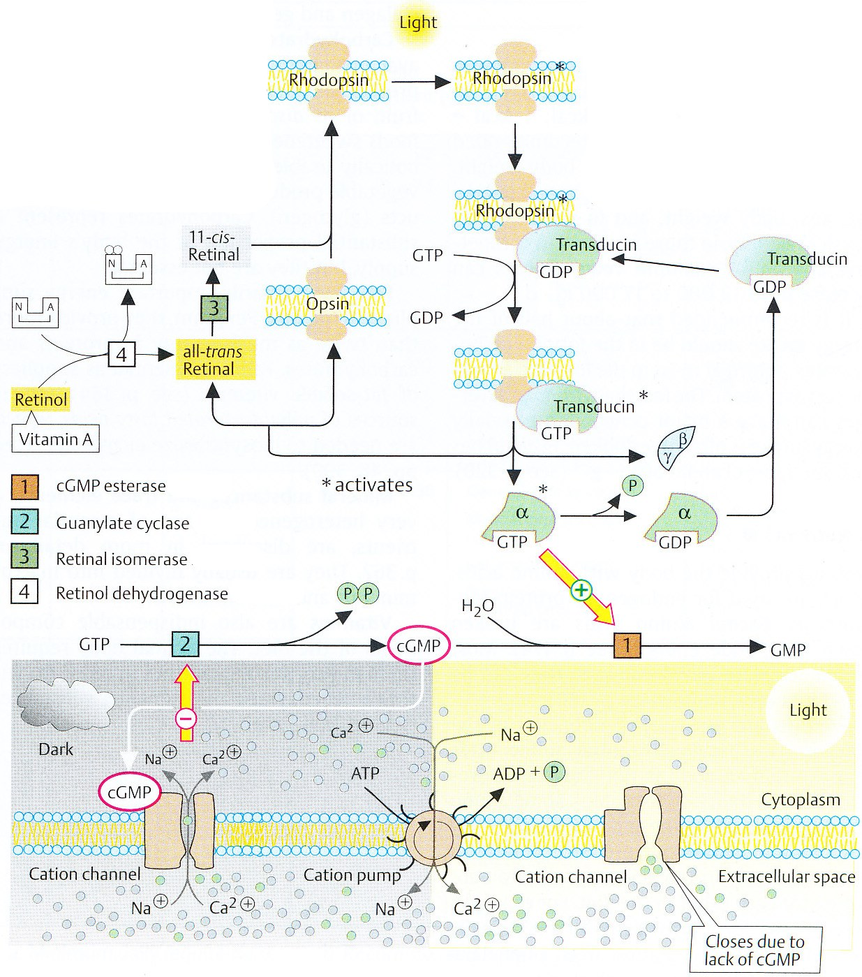
Signal cascade of sight
Dark:
High concentration of cGMP (70μM)
An ion channel opening
Inflow of cationts
Depolarization
Release of glutamate
Light:
Rhodopsin → activation of transducin
α-subunit activates cGMP phosphodiesterase
Reduced amount of cGMP
An ion channel closing
Hyperpolarization
Reduced release of glutamate
Regeneration
1. Inactivation of cGMP esterase
2. Activation of guanylate cyclase
3. Retinal isomerase

Slide 25
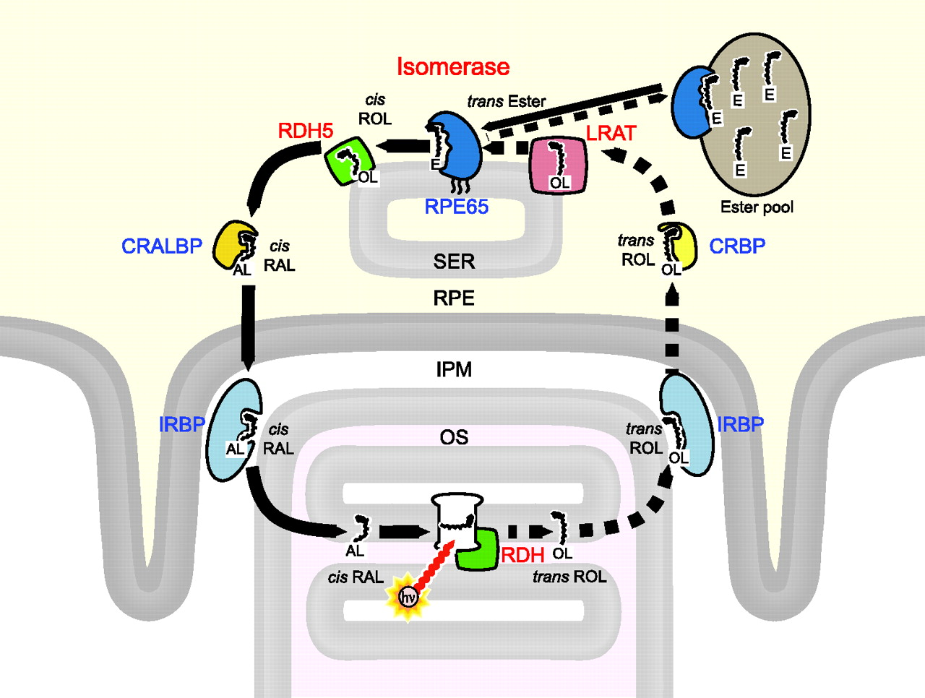
Light adaptation
OS, outer segment; IPM, interphotoreceptor matrix; RPE, retinal pigment epithelium; SER, smooth endoplasmic reticulum; RAL, retinaldehyde; ROL, retinol. For the chemical icons: AL, OL, and E denote the aldehyde, alcohol, and ester groups attached to the retinoid hydrocarbon chain. Enzymes (red): RDH, all-trans retinol dehydrogenase; LRAT, lecithin retinyl acyl transferase; RDH5, 11-cis retinol dehydrogenase. Chaperone proteins (blue): IRBP, interphotoreceptor retinoid binding protein; CRBP, cellular retinol binding protein; RPE65, retinal pigment epithelium 65 kDa protein (which has recently been identified as the isomerase⁵¹ ⁵² ⁵³ ); CRALBP, cellular retinaldehyde binding protein.
Notes:
OS, outer segment; IPM, interphotoreceptor matrix; RPE, retinal pigment epithelium; SER, smooth endoplasmic reticulum; RAL, retinaldehyde; ROL, retinol. For the chemical icons: AL, OL, and E denote the aldehyde, alcohol, and ester groups attached to the retinoid hydrocarbon chain. Enzymes (red): RDH, all-trans retinol dehydrogenase; LRAT, lecithin retinyl acyl transferase; RDH5, 11-cis retinol dehydrogenase. Chaperone proteins (blue): IRBP, interphotoreceptor retinoid binding protein; CRBP, cellular retinol binding protein; RPE65, retinal pigment epithelium 65 kDa protein (which has recently been identified as the isomerase⁵¹ ⁵² ⁵³ ); CRALBP, cellular retinaldehyde binding protein.

Slide 26
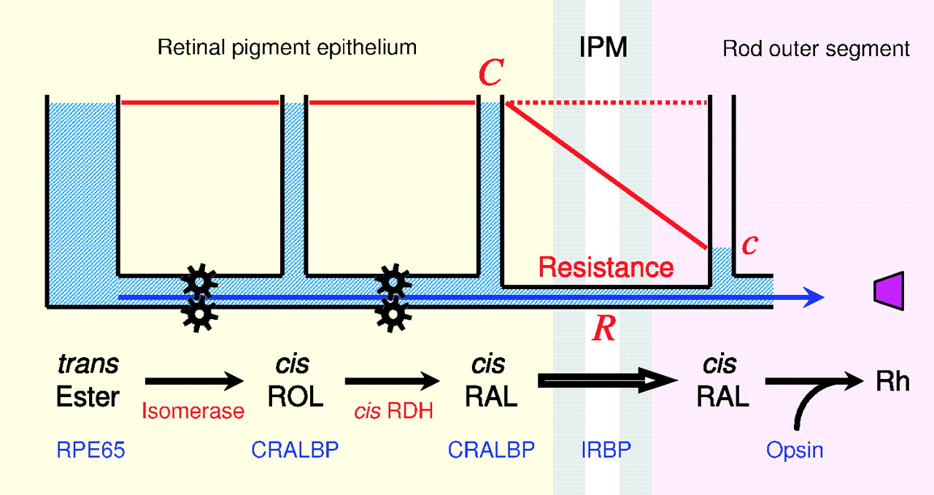
Light adaptation

Slide 27
Pictures used in the presentation:
Marks´ Basic Medical Biochemistry, A Clinical Approach, third edition, 2009 (M. Lieberman, A.D. Marks)
Color Atlas of Biochemistry, second edition, 2005 (J. Koolman, K-H. Roehm)

