Slide 1
METABOLISM of ADIPOSE TISSUE
2. LF UK
Prof. Rudolf Poledne, PhD.

Slide 2
TYPES OF ADIPOSE TISSUE
brown adipose tissue
subcutaneous adipose tissue
visceral adipose tissue

Slide 3
ADIPOSE TISSUE FUNCTIONS:
thermal isolation
mechanical protection
reserve of energy
endocrine organ
pro- and antiinflammation function

Slide 4
MUSCLE ENERGY RESOURCES
ATP + GP
AEROBIC OXIDATION OF FFA
GLYCOLEN
0
1
2
3
4
5
6
HOUR

Slide 5
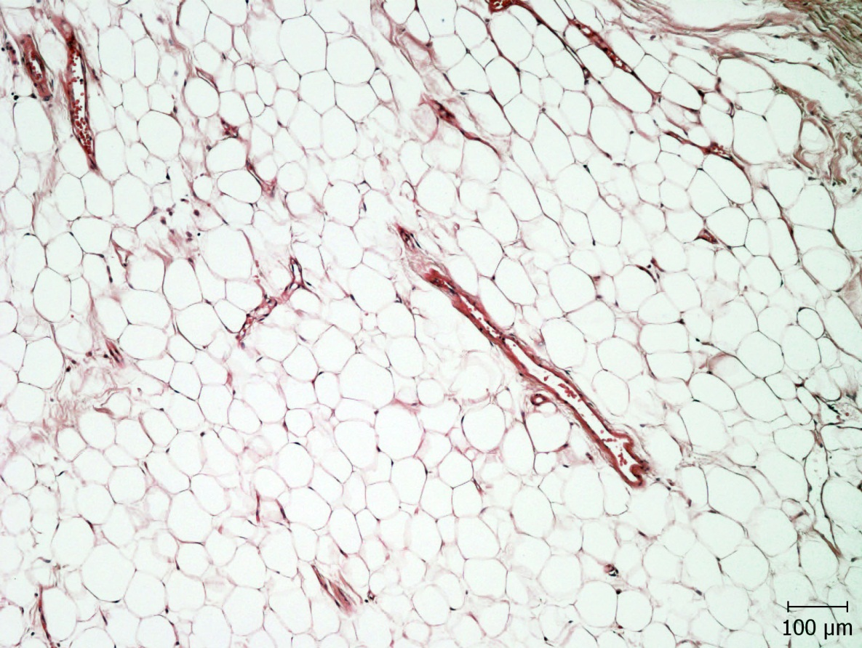

Slide 6
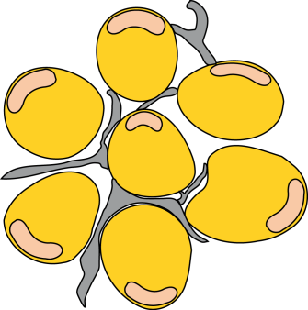




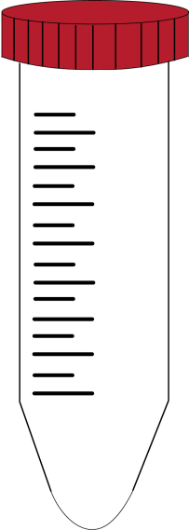


ADIPOSE TISSUE AS ENDOCRINE ORGAN
WHITE ADIPOSE TISSUE
ADIPOSE – TISSUE MATRIX
(ENDOTHELIAL, SMOOTH MUSCLE AND FIBROBLAST CELLS)
FRACTION 1
FILTER – RETAINED
FRACTION
PAI – 1, IL – 8, VEGF, IL – 6
IL – 1β, IL – 10, TNFα,
ADIPONECTIN
COLLAGENASE
DIGESTION
FILTER 200 μm MESH
ADIPOCYTES
CENTRIFUGE
FILTRATE
LEPTIN, ADIPONECTIN
FRACTION 2
FLOATING FRACTION
STROMAL VASCULAR CELLS
(MONOCYTES/MACROPHAGES/PREADIPOCYTES)
FRACTION 3
NON –FAT FRACTION
TNF α

Slide 7
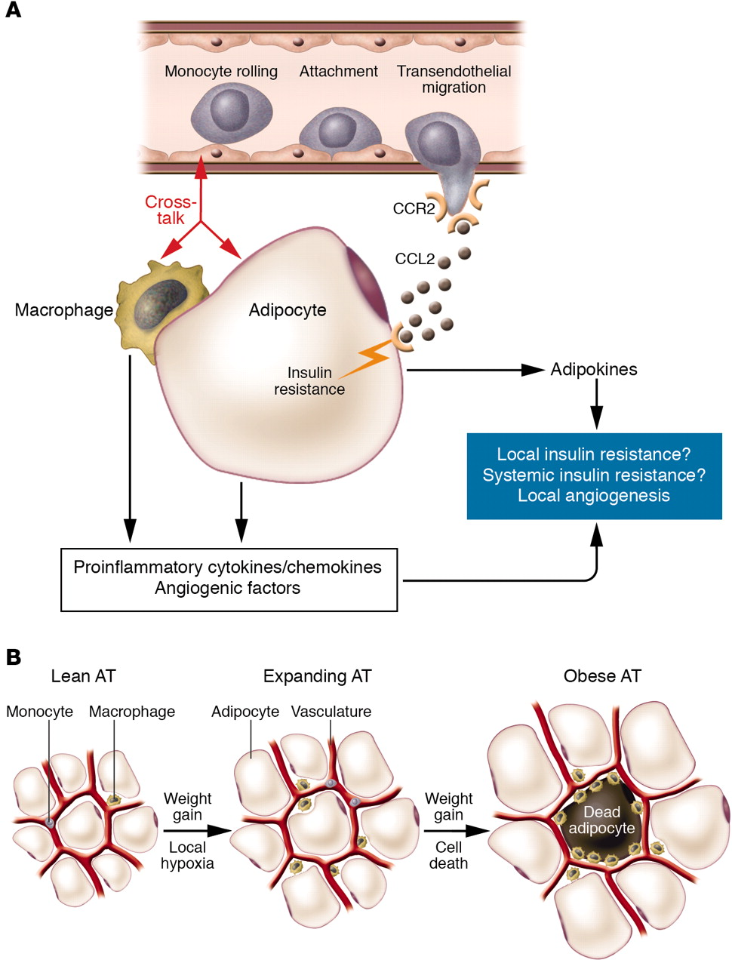
DAMP signály při excesivní obezitě
J. Clin. Invest. 2006;116:33-35

Slide 8
Reserve of energy

Slide 9
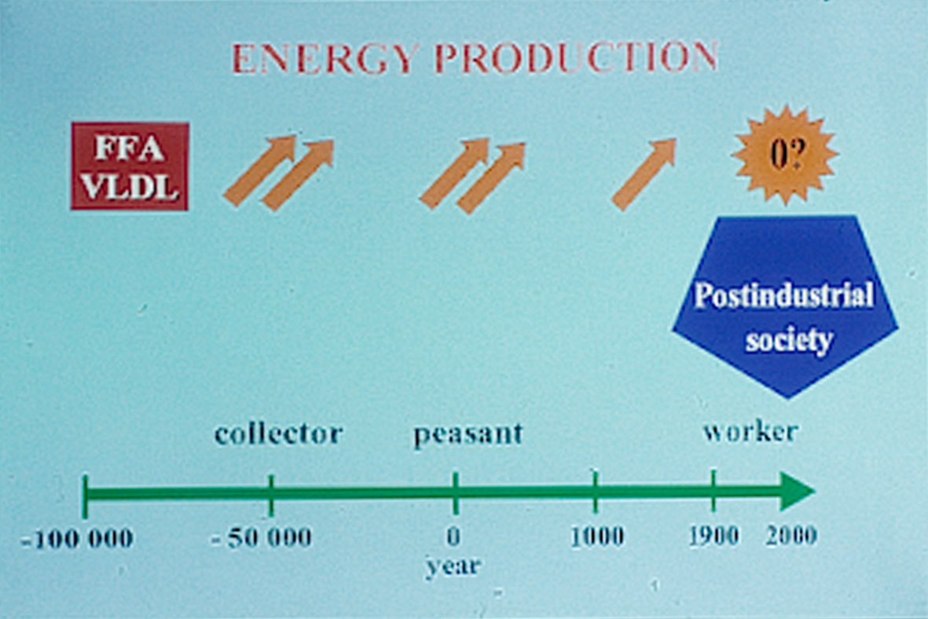

Slide 10
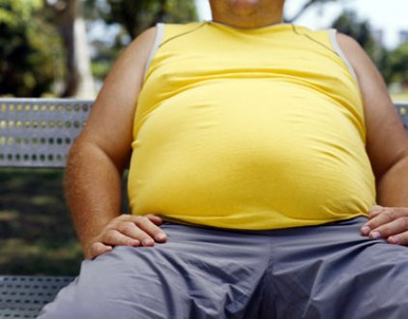
Aterogenic effect of visceral adipose tissue
Dyslipoproteinemia
VLDL1 – high density LDL
Interleukin 6, adiponectin
VCAM, ICAM
Monocyte changes after pasage of adipose tissue

Slide 11
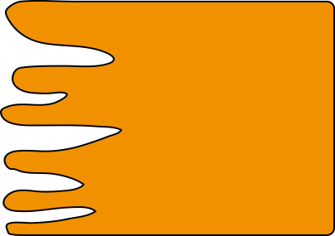

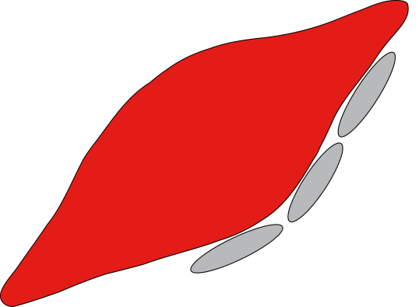

Exogenous fat intake
INTESTINE
FFA
2 – MG
TG
apoB – 48
CHYLOMICRONS
ADIPOSE T.
LPL
LPL
MUSCLE
FFA
CHYLOM.
REMNANTS
FFA
FATP
ATP
LRP
FFA
LIVER

Slide 12
APO A V
APO E
triglycerides
cholesterol-esters
FC
PL
APO A I
APO B 48

Slide 13
Postprandial lipoprotein metabolism
C
C
C
lipoprotein lipase
CR
CR
LRP
LDL R
(
(
LDL R
LRP

Slide 14
APO E
APO A V
nascent. HDL
triglycerides
cholesterol-esters
APO B 48
APO A I
remnant

Slide 15
SAFA inflammation stimulation TLR 4
PUFA ω3 inflammation inhibition TLR 4

Slide 16
ADIPOCYTE
SAFA
TLR4
NFκB
MACROPHAGE
IL-6
IL-8
ACCELERATION OF PROINFLAMMATION STATUS
CRP

Slide 17
SAFA
SAFA
n = 9
PUFA
PUFA
n = 9
4 weeks
4 weeks
Animal fats 30%
Diet: fat total 40%
Animal fats 10%

Slide 18
CRP concentration
mmol/l
p < 0,05

Slide 19


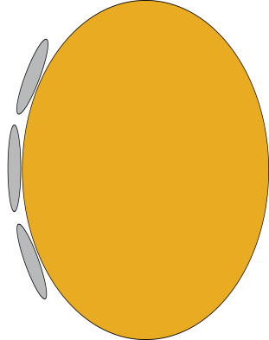
GLUCOSE
HEPATOCYTE
FFA
BILE A.
FFA
TG
CHOL.
apoB 100
LDLR
VLDL
ADIPOSE TISSUE
FFA
LDL
IDL
LDL R
FC
PERIPHERAL CELLS

Slide 20

FASTING
HSL
FFA
TG
FFA
LPL
FFA
LPL
ATP
apoB 100
VLDL

Slide 21

CATECHOLAMINES
HSL
INSULIN
X
PERILIPIN

Slide 22
OBESITY – LOW PHYSICAL ACTIVITY – INSULIN RESISTANCE
HSL
FFA
TG
GLUCSE
CHYLOM.
VMK
TG
ATP
OXID
X
FFA
TG
VLDL

Slide 23
SAFA inhibuje tvorbu receptorů LDL-rec.
zvyšuje koncentraci cholesterolu
PUFA ω3 stimuluje tvorbu receptorů LDL-rec.
snižuje koncentraci cholesterolu

Slide 24
STEATOSIS – NAFL – NASH
X
FFA
OXID
TG
apoB 100
VLDL (large)
LDL (small dense)

Slide 25
Metabolismus TG-bohatých lipoproteinů
Normální regulace Inzulínová rezistence
TG
TG
VLDL
VLDL 1
IDL
IDL
IDL
LDL
LDL

Slide 26
Adipose tissue as endocrine organ

Slide 27
Aterogenic effect of visceral adipose tissue
Dyslipoproteinemia
VLDL1 – high density LDL
Interleukin 6, adiponectin
VCAM, ICAM
Monocyte changes after pasage of adipose tissue

Slide 28




EFFECT OF LEPTIN
LEPTIN
HYPOTHALAMUS
FOOD INTAKE
FA synthesis
FA synthesis
TG synthesis
IL6 synthesis
FA oxidation
Permeability
FOOD INTAKE

Slide 29

INFLUENCE OF ADIPONECTIN
ADIPONECTIN
GLUCO-
NEOGENESIS
INTERLEUKIN-6
OXIDATION FA
TNF α
PERMEABILITY
MØ

Slide 30
BMI AND RISK OF MI
(US Nurses Study)
BMI RR Signif.
21 – 22 1.0
23 – 25 1.3 *
25 – 27 1.6 **
27 – 30 1.8 ***
> 30 2.7 ***

Slide 31
Pro- and antiinflammation functions

Slide 32
Aterogenic effect of visceral adipose tissue
Dyslipoproteinemia
VLDL1 – high density LDL
Interleukin 6, adiponectin
VCAM, ICAM
Monocyte changes after pasage of adipose tissue

Slide 33
PROINFLAMMATION STATUS POTENTIATION
SYNTHESIS
TNF α
NF ƙ B
TNFα
IL 6
MØ
TNFα
Il6
MCP

Slide 34
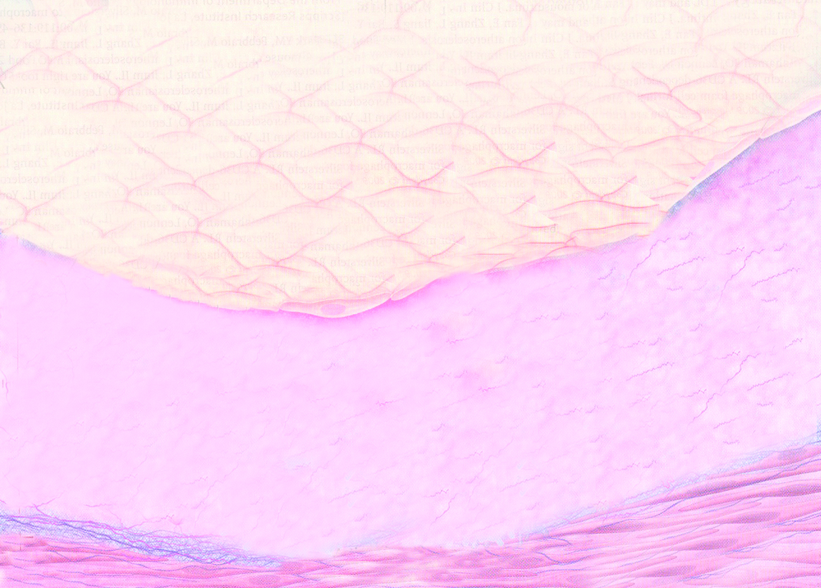

Slide 36
Monocyte run through adipose tissue
Arterial wall
Proinflammatory status
CRP
Adipose tissue

Slide 37
Protocol of the study:
Volunteers:
40 women aged 25-35 yrs
BMI over 28
9 weeks of dietary intervention (energy intake to 8000 kJ)
9 weeks of controlled physical activity (puls frequence 65% max. PF)

Slide 38
Energy and fat intake
[mmol/l]
90
12000
80
*
10000
70
ns
60
8000
50
ns
baseline
6000
after int.
40
30
4000
ns
20
2000
10
0
0
Energy
animal
vegetable
total fat
fat
fat

Slide 39
Changes in anthropometric parameters
[cm]
120
110
****
100
baseline
after intervention
90
****
ns
80
70
WHR
waist
hips

Slide 40
Changes in lipoprotein parameters
[mmol/l]
6
ns
5
4
ns
baseline
3
after int.
2
ns
*
1
0
Trigycerides
total
LDL
HDL
cholesterol
cholesterol
cholesterol

Slide 41
Changes in glycemia, insulin and leptin
[%]
150
140
*
130
120
110
ns
baseline
100
after int.
*
90
80
70
**
60
Glycemia
Insulin
Leptin
Leptin rec

Slide 42
Changes in blood pressure and pulses
[%]
105
100
ns
95
****
***
90
85
baseline
80
after int.
75
70
65
60
systolic BP
diastolic BP
pulses

Slide 43
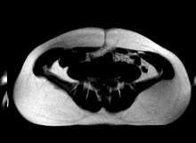
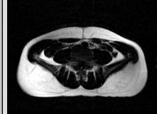

Slide 44
C-reactive protein
p < 0,0002
4,31 ± 3,71
3,01 ± 3,12

Slide 45
In addition to energy reserve adipose tissue is:
an important endocrine organ
influencing of proinflammation status and accelerating atherogenesis

