Slide 2
Decreased Insulin Receptor Kinase Activity in Gestational Diabetes Mellitus
during pregnancy – decrease in insulin sensitivity – helps provide adequate glucose for the developing fetus
3-5% of pregnant women, glucose intolerance develops
GDM: decrease in insulin sensitivity and inability to compensate with increased insulin secretion
Defects in insulin action, rather than a decrease in insulin receptor binding affinity
Skeletal muscle cells of GDM women appear to overexpress plasma cell membrane glycoprotein-1, which inhibits tyrosine kinase activity of the insulin receptor

Slide 3
Apparent Mineralocorticoid Excess Syndrome
Hypertension, hypokalemia and suppression of the renin-angiotensin-aldosterone system
Failure of inactivation of cortisol by 11b-hydroxysteroid dehydrogenase.
Plasma levels of cortisol are about 100x higher than the levels of aldosterone
Cortisol saturates the renal mineralocortocoid receptor – Na retention, supression of the renin-angiotensin-aldosteron axis.
Congenital defect
Ingesting excessive amounts of licorice – glycyrrhizic acid

Slide 4
Mineralocorticoid Receptor Mutation Results in Hypertension and Toxemia of Pregnancy
Hypertension associated with toxemia of pregnancy (eclampsia)
6% pregnancies
Mutation in the mineralocarticoid receptor( Ser at position 810 is replaced by a Leu – it is in hormone binging domain
Mutant receptor binds progesterone with the same affinity as aldosterone –functions as an agonist and induces reabsorption of sodium ions in the kidney.
Subjects under age 35 carrying the mutated receptor have blood pressure 167/110 (126/78)
! Spironolactone should not be used to treat hypertensive patients bearing the S810L mutation !

Slide 5
Endocrine disruptors

Slide 6
Endocrine disruptors
Endocrine Disrupting Compounds (EDCs)
Any exogenous chemicals that interferes with the production, release, transport, elimination of natural hormones responsible for the maintenace of homeostasis and regulation of developmental processes.
Stimulate or inhibit the endocrine system causing over or under production of natural hormones
The interaction with the functions of estrogens, androgens, and thyroid hormones have bee the most highly studied

Slide 7
Endocrine disruptors
Pesticides – DDT
Herbicides - atrazine
Fungicides - viclozolin
Plasticizers - phthalates
Surfactants
Organometals
Phytoestrogens

Slide 8
Endocrine disruptors
Serving as steroid receptor ligands
  Activate a receptor – act as a hormone
  Receptors respond at inappropriate times
  Block a receptor by competing with other hormones
Modifying the number of hormone receptors in a cell
Modifying steroid hormone-metabolizing enzymes
Perturbing hypothalamic pituitary release of trophic hormones
Miscellaneous or unknown

Slide 9
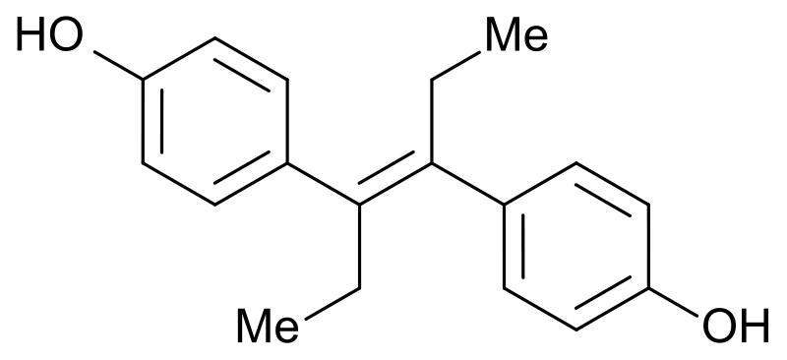
DES - diethylstilbesterol
morning after pill or during pregnancy to prevent women from having a miscarriage or giving birth too early.
DES daugthers increased risk for infertility, miscarriage, ectopic pregnancies
DES sons: evidence of increased risk:
  Undescended testicles
  Poorer sperm quatlity

Slide 10
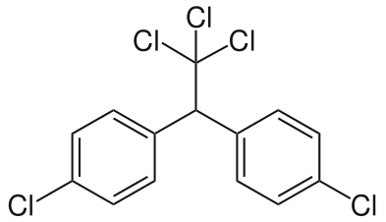

DDT dichlorodiphenyltrichloroethane
The breakdown product of DDT, DDE is able to act as an anti-androgen by blocking the testosterone receptor and producing effects that are phenotypically similar to those caused by estrogens
Reproductive abnormalities, particularly in wildlife species:
The American alligator - abnormalities gonads
Birds –eggshell thinning and resulted in sever
population decline
Notes:
The alligator population at Lake Apopka in central Florida declined dramatically between 1980 and 1987. Endocrine-disrupting chemicals and specifically DDT metabolites have been implicated in the alligators' reproductive failure. The DDT metabolite hypothesis is based largely on the observation of elevated concentrations of p,p-DDE and p,p-DDD in alligator eggs obtained from Lake Apopka in 1984 and 1985. In the following commentary, we draw attention to two nematocides that are established reproductive toxins in humans, dibromochloropropane (DBCP) and ethylene dibromide (EDB), which could also have played a role in the reproductive failure observed in alligators from Lake Apopka in the early 1980s. We have observed that neonatal and juvenile alligators living in pesticide-contaminated lakes have altered plasma hormone concentrations, reproductive tract anatomy and hepatic functioning. Experimental studies exposing developing embryos to various persistent and nonpersistent pesticides, have produced alterations in gonadal steroidogenesis, secondary sex characteristics and gonadal anatomy. Atrazine, however, at ppm doses can induce elevated testicular expression of the steroidogenic enzyme aromatase in alligator males if exposure occurs in ovo. Atrazine, like p,p′-DDE, exhibits a low affinity for the alligator estrogen receptor (Vonier et al., 1997). 2,4-D does not influence aromatase activity in alligators at the treatment doses used (Crain et al., 1997).

Slide 11
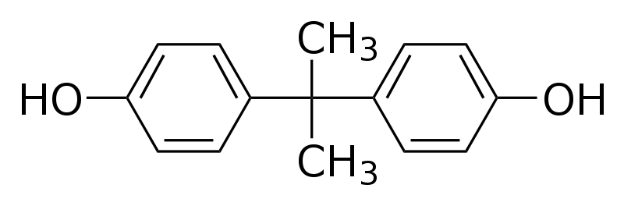

Bisphenol A
Plastics ingredient – production of polycarbonate plastics and epoxy resins (plastic bottles, food storage containers, CDs)
Estrogenic effect
Obesity, diabetes
Development of prostate, breast and uterine cancer
2011 EU committee banned sale of polycarbonate
baby bottles containing bisphenol A

Slide 12
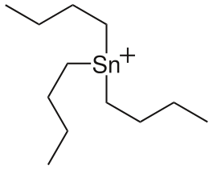

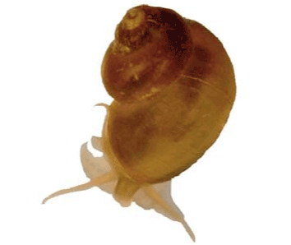
Tributyltin (TBT)
Used as anti-foulant for boats
Prevent the growth of marine organisms on the hulls of large ships
TBT also causes imposex (development of male characteristics in females) in marine gastropods and is probably responsible for reductions in their populations in zones with important ship traffic.

Slide 13
Timing of Exposure
Sensitivity of an individual to ECDs depends on where he/she is temporally in life.
May have little or no impact on a young/older adult, but may have profound development-disrupting effects if exposure occurs in utero.

Slide 14
Syndromes affecting multiple endocrine glands

Slide 15
Multiple endocrine neoplasia (MEN)
Tumors of 2 or more endocrine glands(parathyroid gland,pituitary, pancreas, adrenal gland)
Autosomal dominant disease 1:25 000 – 1:50 000
MEN1 – Werner‘s syndrome – cancer of parathyroid gland,pituitary, pancreas
MEN2a – Sipple‘s syndrome – medullary thyroid carcinom, pheochromocytoma
hyperparathyreosa
MEN 2b – MEN3 – medullary thyroid carcinom,
pheochromocytoma
mucosal neuroma, marfanoid habitus

Slide 16
MEN 1
Tumors of parathyroid gland, pituitary gland, pancreas gland
Mutation in gene located on chromosome 11
Tumors benign or malignant
1. 90% pacients hyperparathyroidsm ↑ hladiny Ca²⁺
kidney stones, osteoporosis, hypertension
2. 80 % patients pancreatic tumors 40% in B cells – over secretion of insulin
tumor of non-beta cells – over secretion of gastrin
diarrhea, gastric ulcers
3. 65% pituitary tumor- ↑ACTH – Cushing‘s syndrome

Slide 17
MEN 1
Diagnosis:
↑ pancreatic polypeptid
↑ ACTH
fasting hypoglycemia
CT, MR
Treatment
Surgery: removal of all four parathyroid glands - Lifetime administration of vitamin D and calcium.

Slide 18
MEN 2
Mutation in proto-oncogen RET
medullary thyroid carcinom
pheochromocytoma
2a + hyperparathyroidism
2b + mucosal neuroma, marfanoid habitus
MTC – Medullar thyroid cancer
from parafolicullar cells( calcitonin)
Manifestation MEN 2a: mezi 25-35. years of age,
MEN 2b: mezi 10. – 20 . years of age, diagnosis in childhood (typical symptomatology )
Pheochromocytoma
50 % pacients with MTC
Manifestation later than MTC (5-8 years later)

Slide 19
MEN 2
Diagnosis:
MTC: measurement of basal and stimulated calcitonin
Pheochromocytoma: often without symptoms
blood pressure measurements,
Determination of plasma / or urinary catecholamines and their matabolits(acid
vanilmandelic)
MEN 2a: determine levels of serum calcium, phosphate, parathyroid hormone
MEN 2b: mucosal neuroma, marfanoid habitus
Molecular genetic analysis of mutations in the RET proto-oncogene
Treatment:
Total thyroidectomy - in more than half of patients metastases to regional lymph nodes at the time of diagnosis

Slide 20
Autoimmune polyglandular syndrome (APS)
Autoimmune inflammation affects simultaneously multiple endocrine glands
Usually hypofunction
APS I
Chronic mucocutaneous candidiasis (3 to 5 years) 100%
autoimmune hypoparathyroidsm (20 years) 80-90%
Addison's disease (30 years) 60-70%
rare occurrence
In childhood
In 57% of patients, all 3 diseases
Mutations in the gene AIRE - autoimmune regulator
APS II:
DM I 70%
autoimmune thyroiditis
Addison's disease 20%
more frequent
In adults aged 30-40. year
The most common combination of DM I and autoimmune thyroiditis

